Slide 1
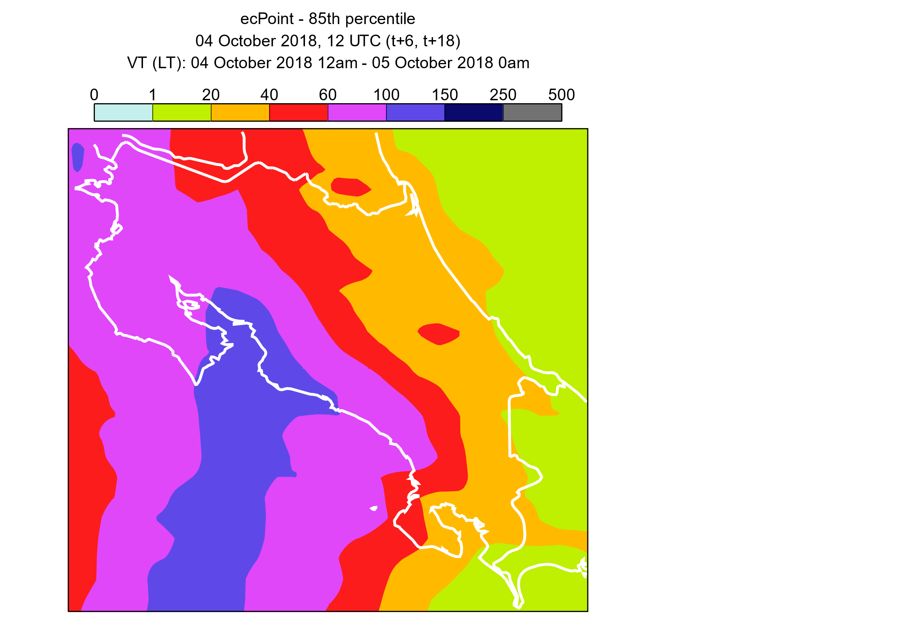
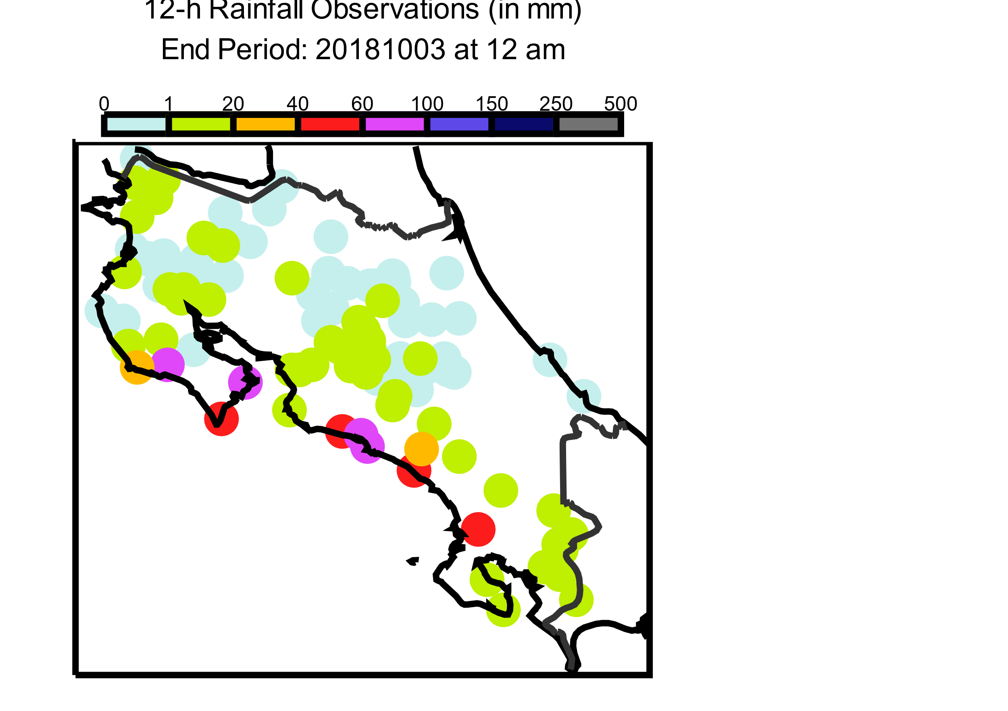
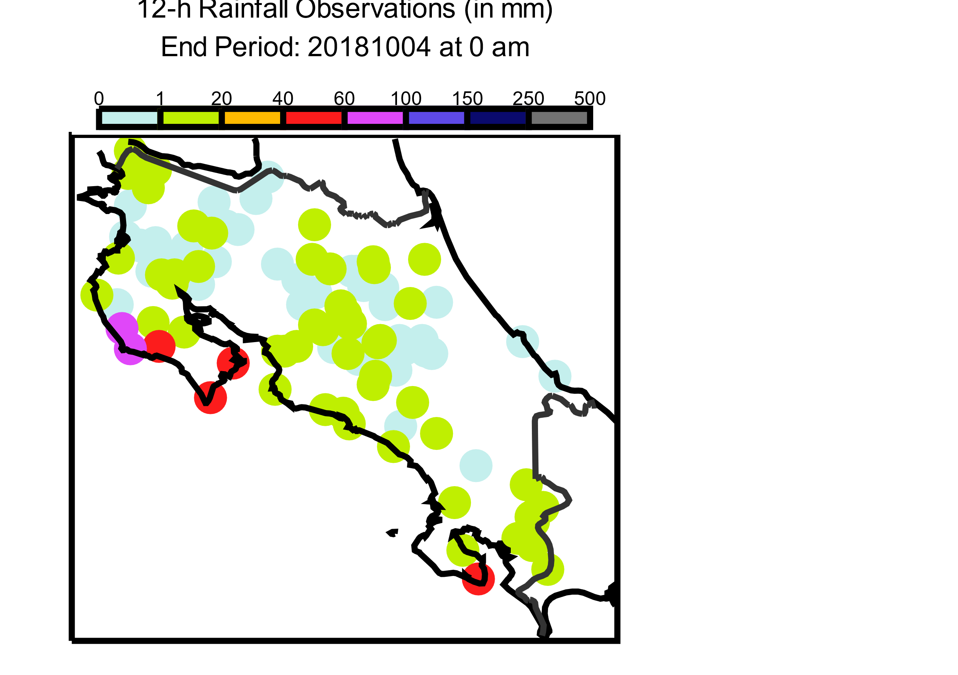
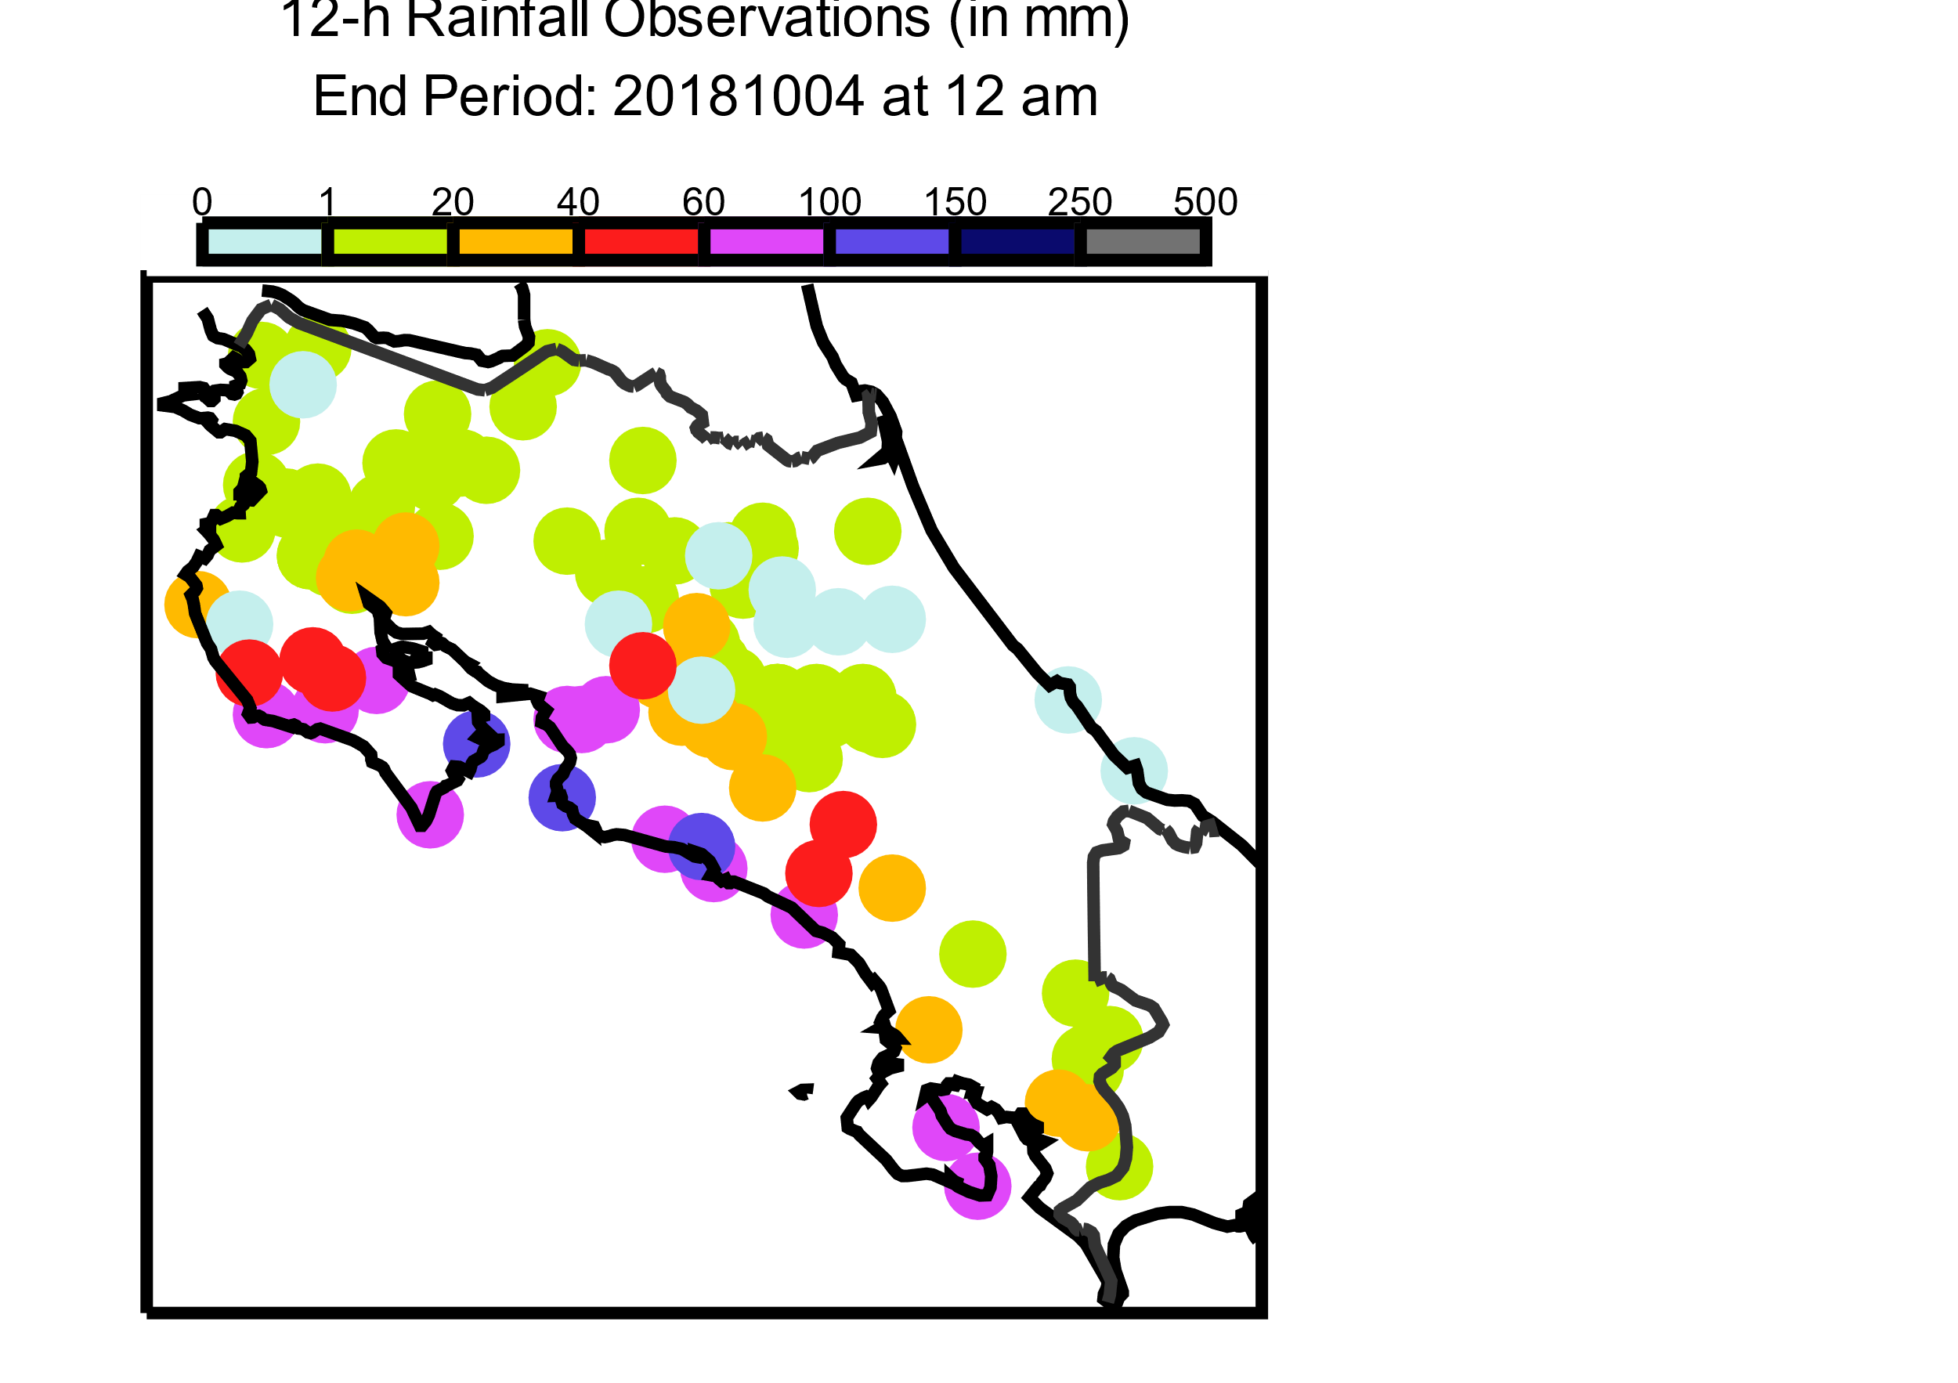
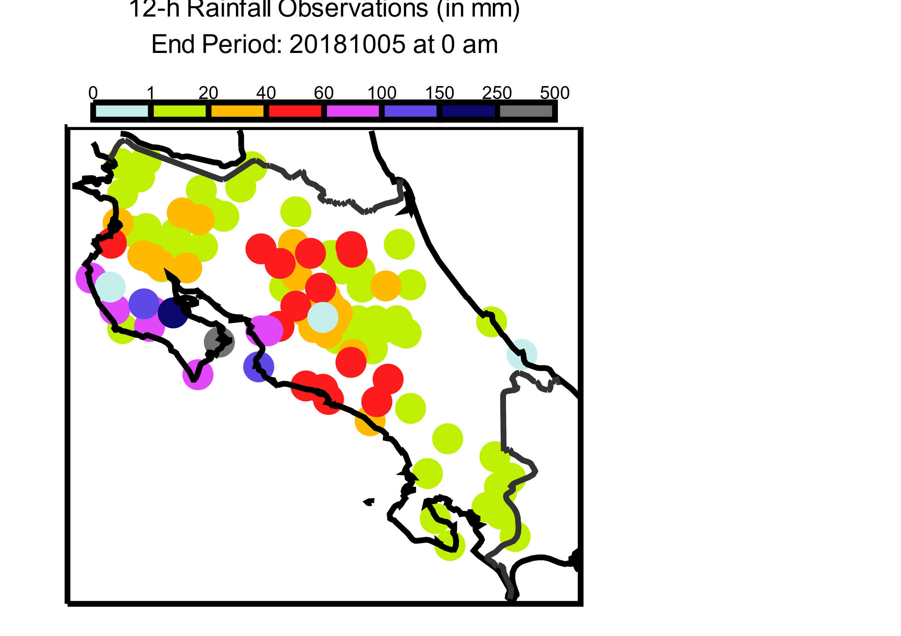
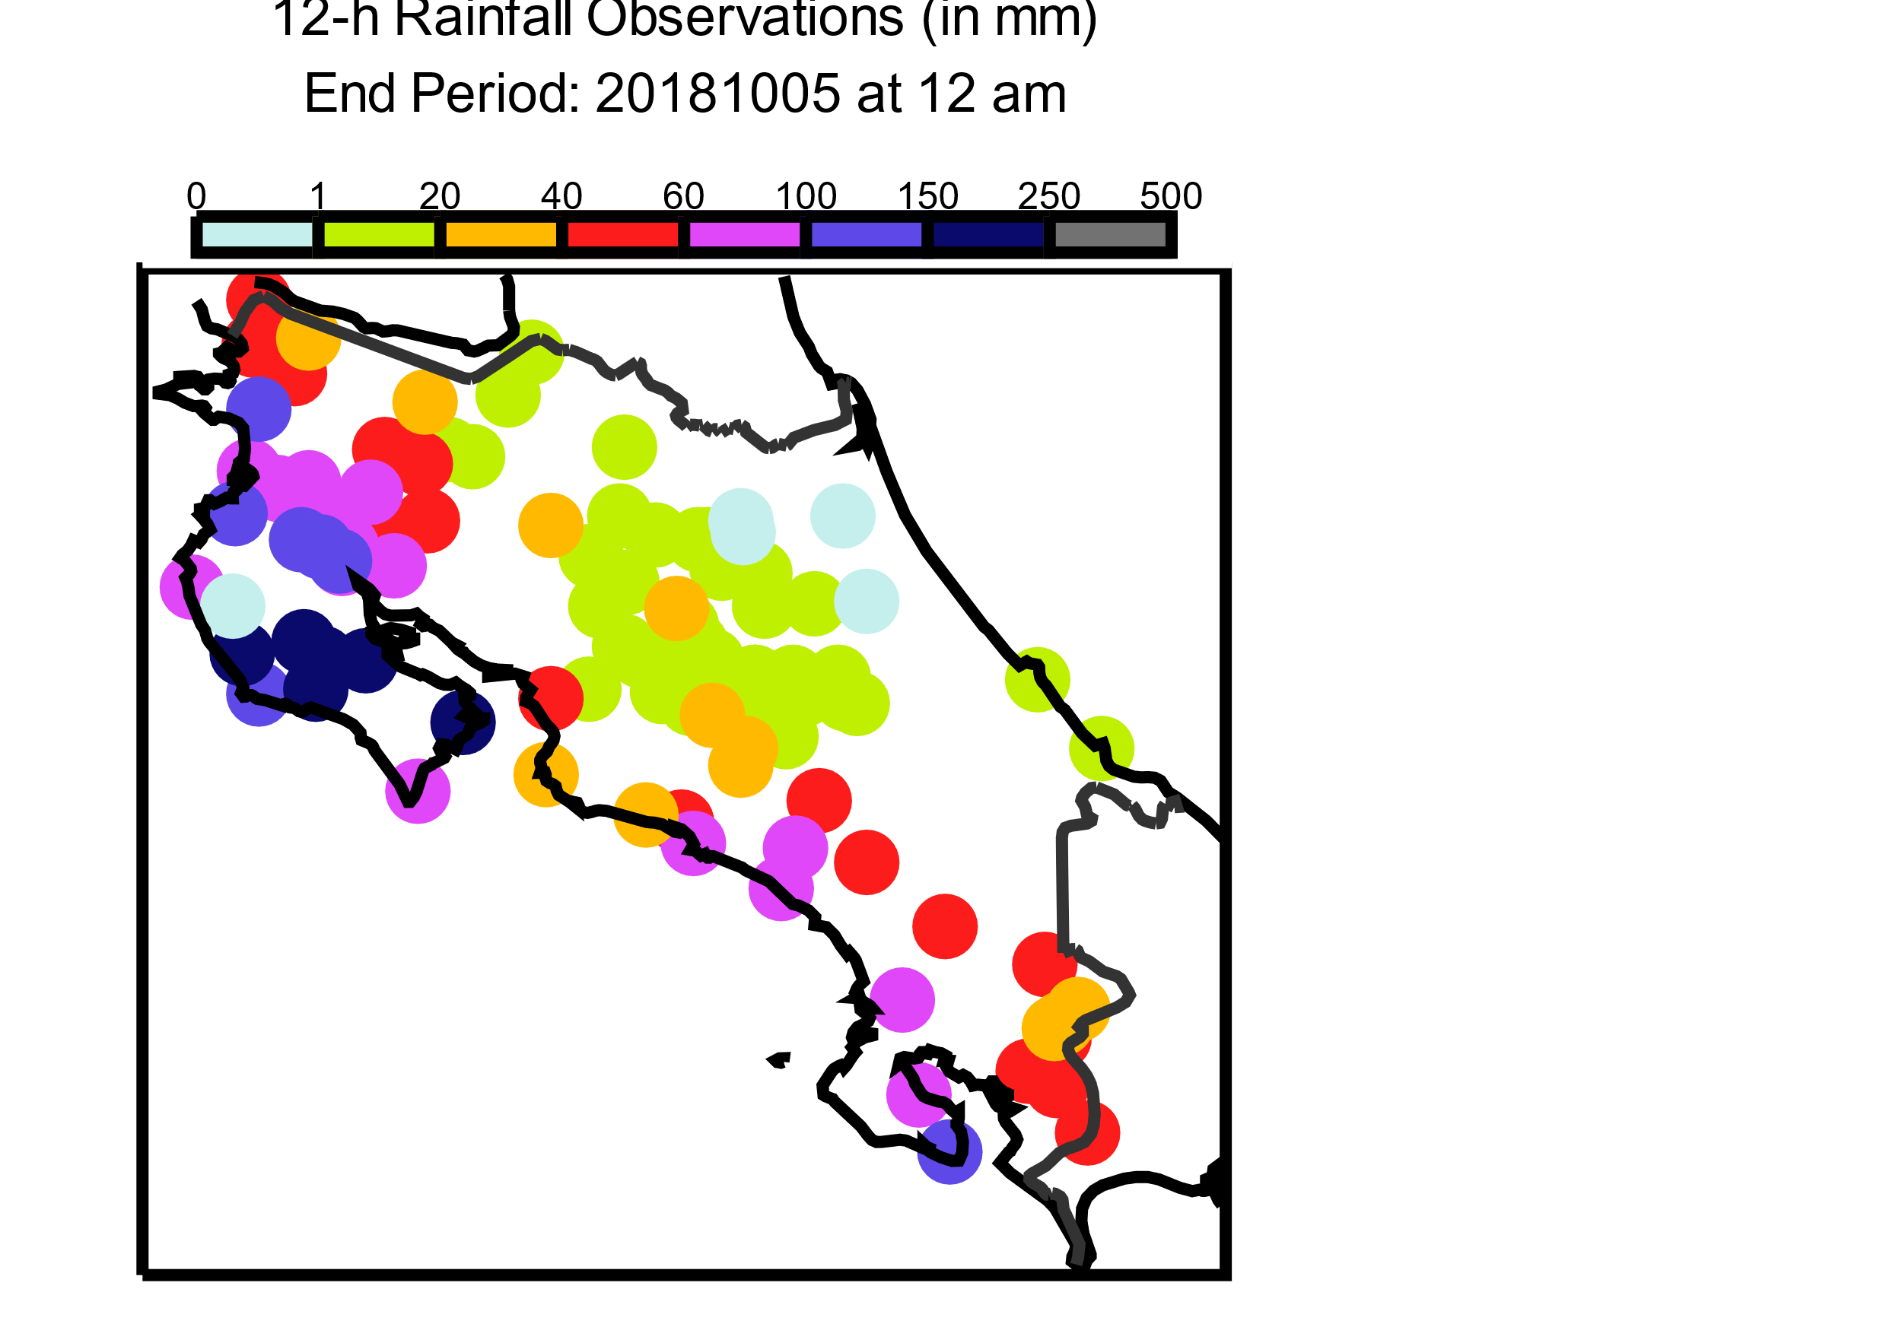
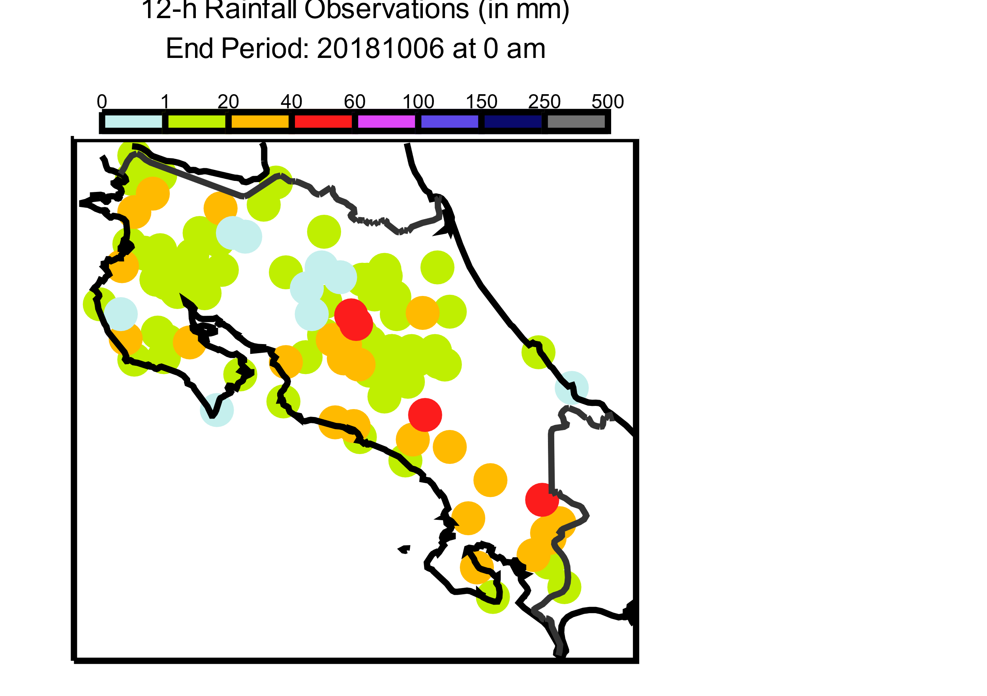
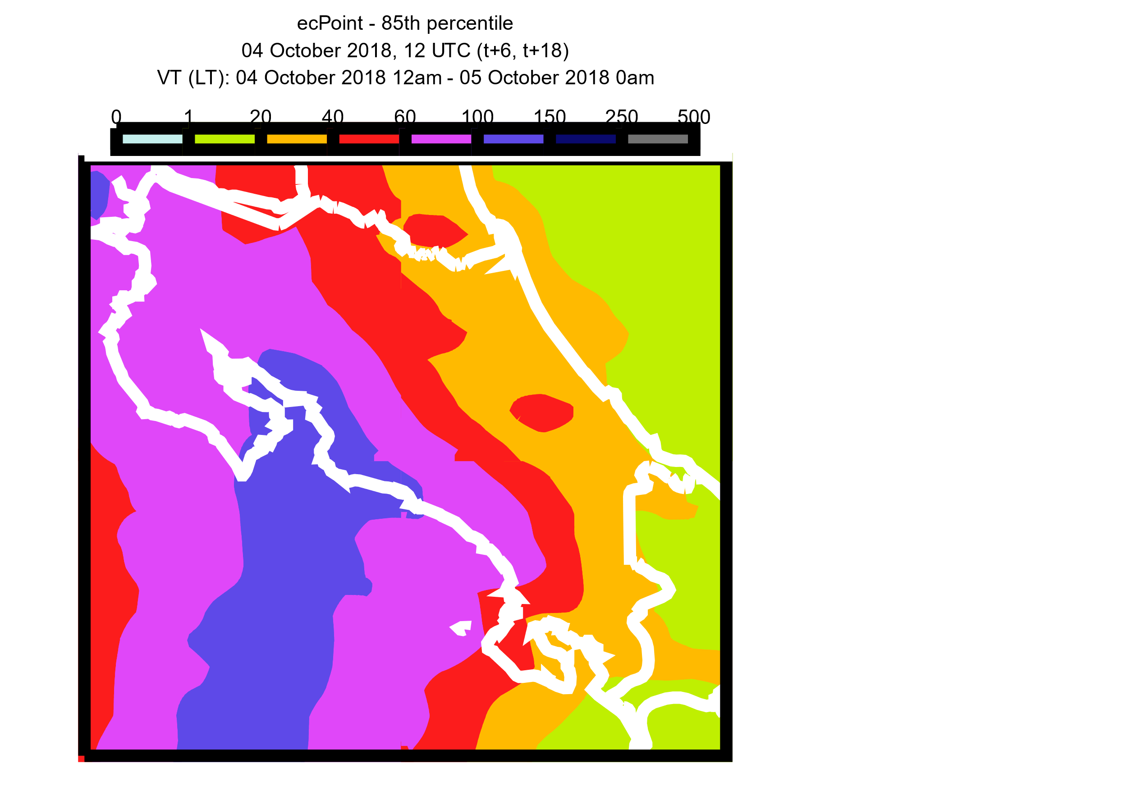
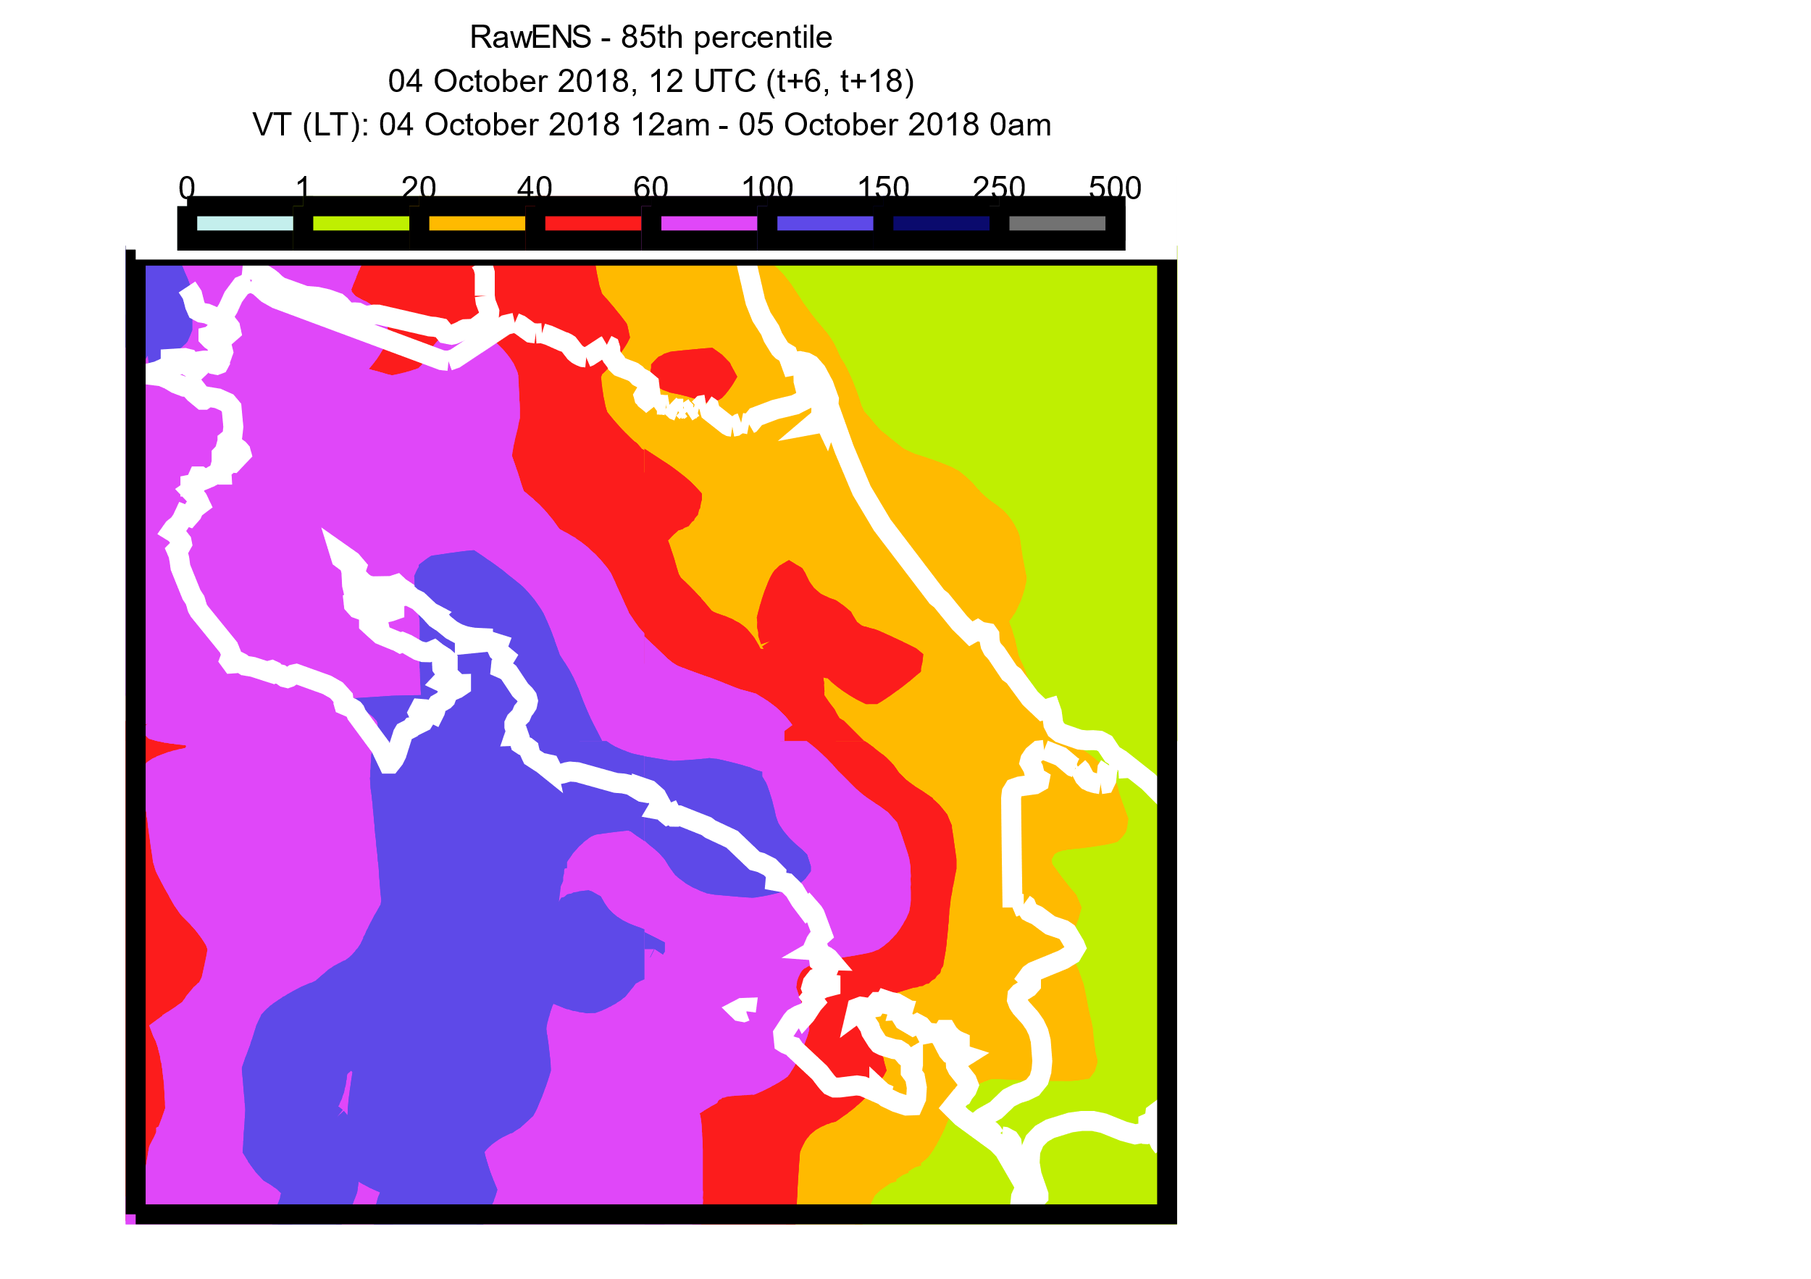
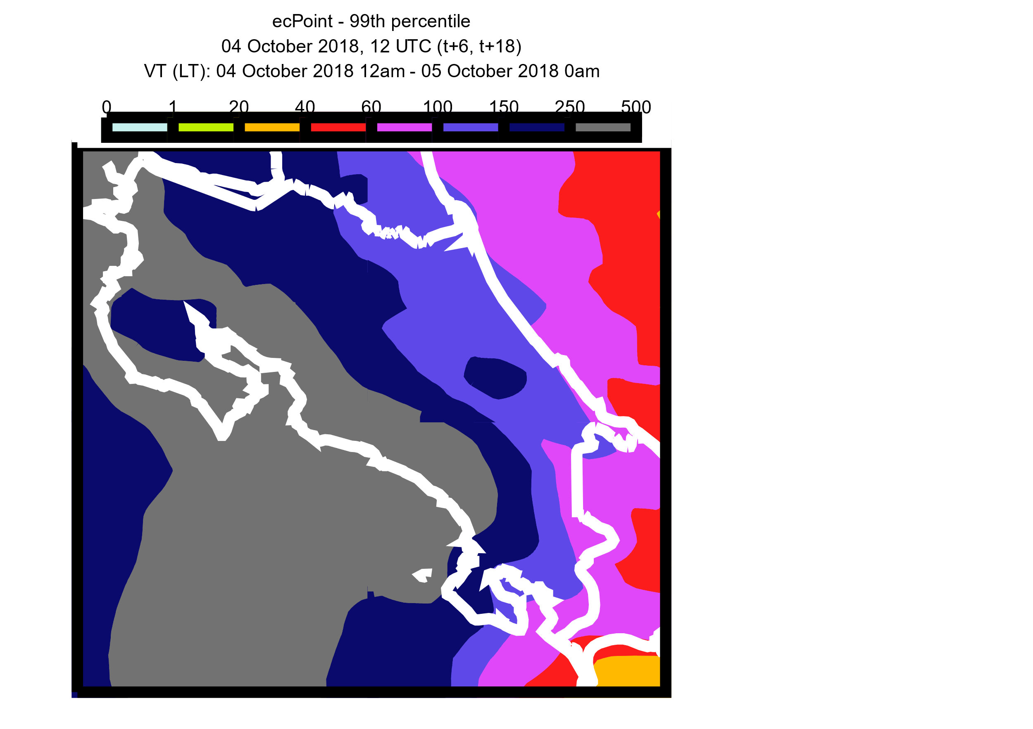
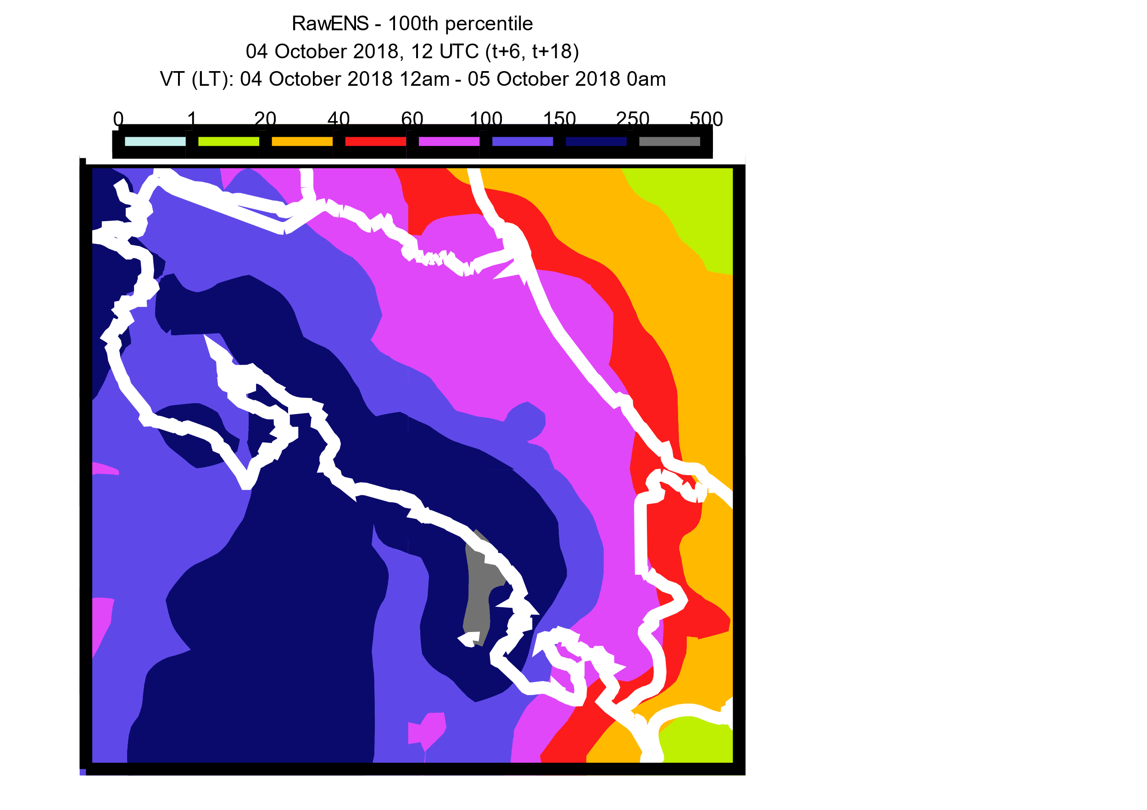
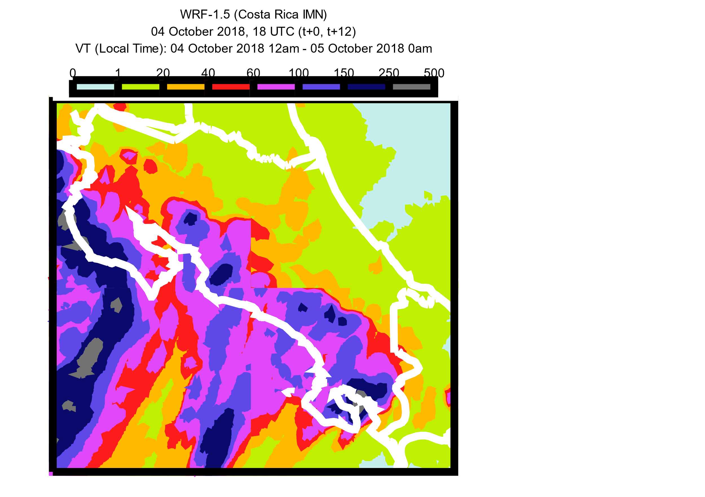
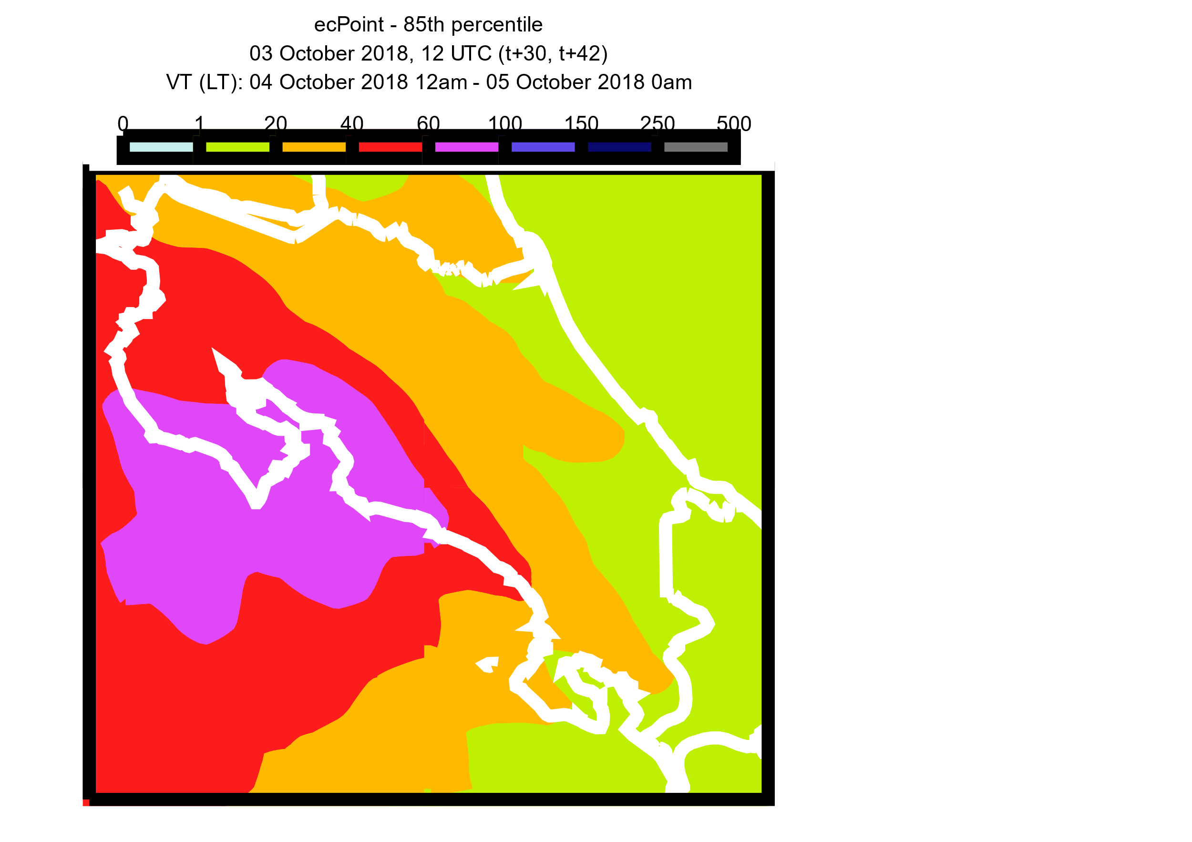
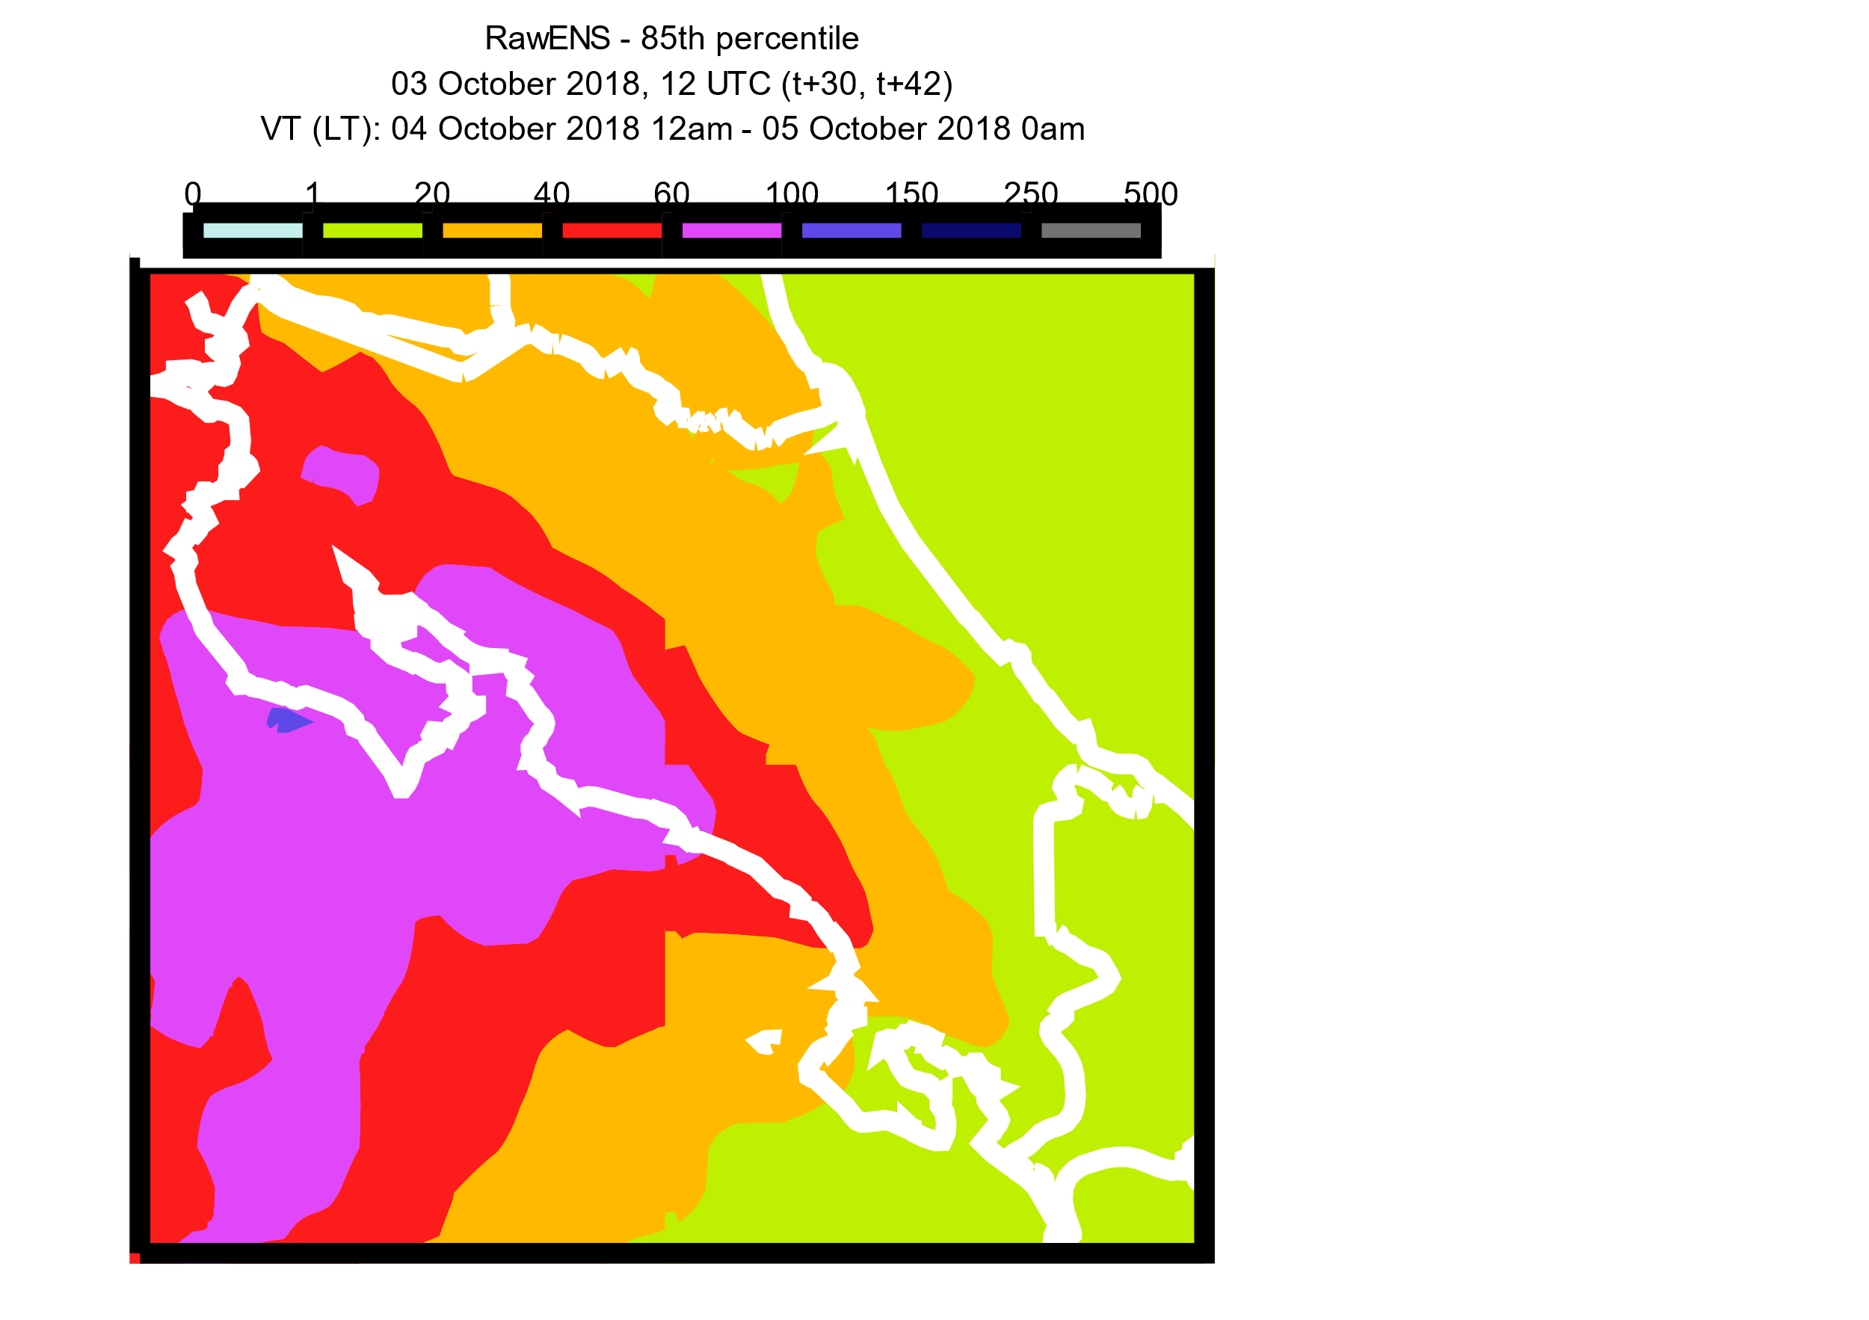
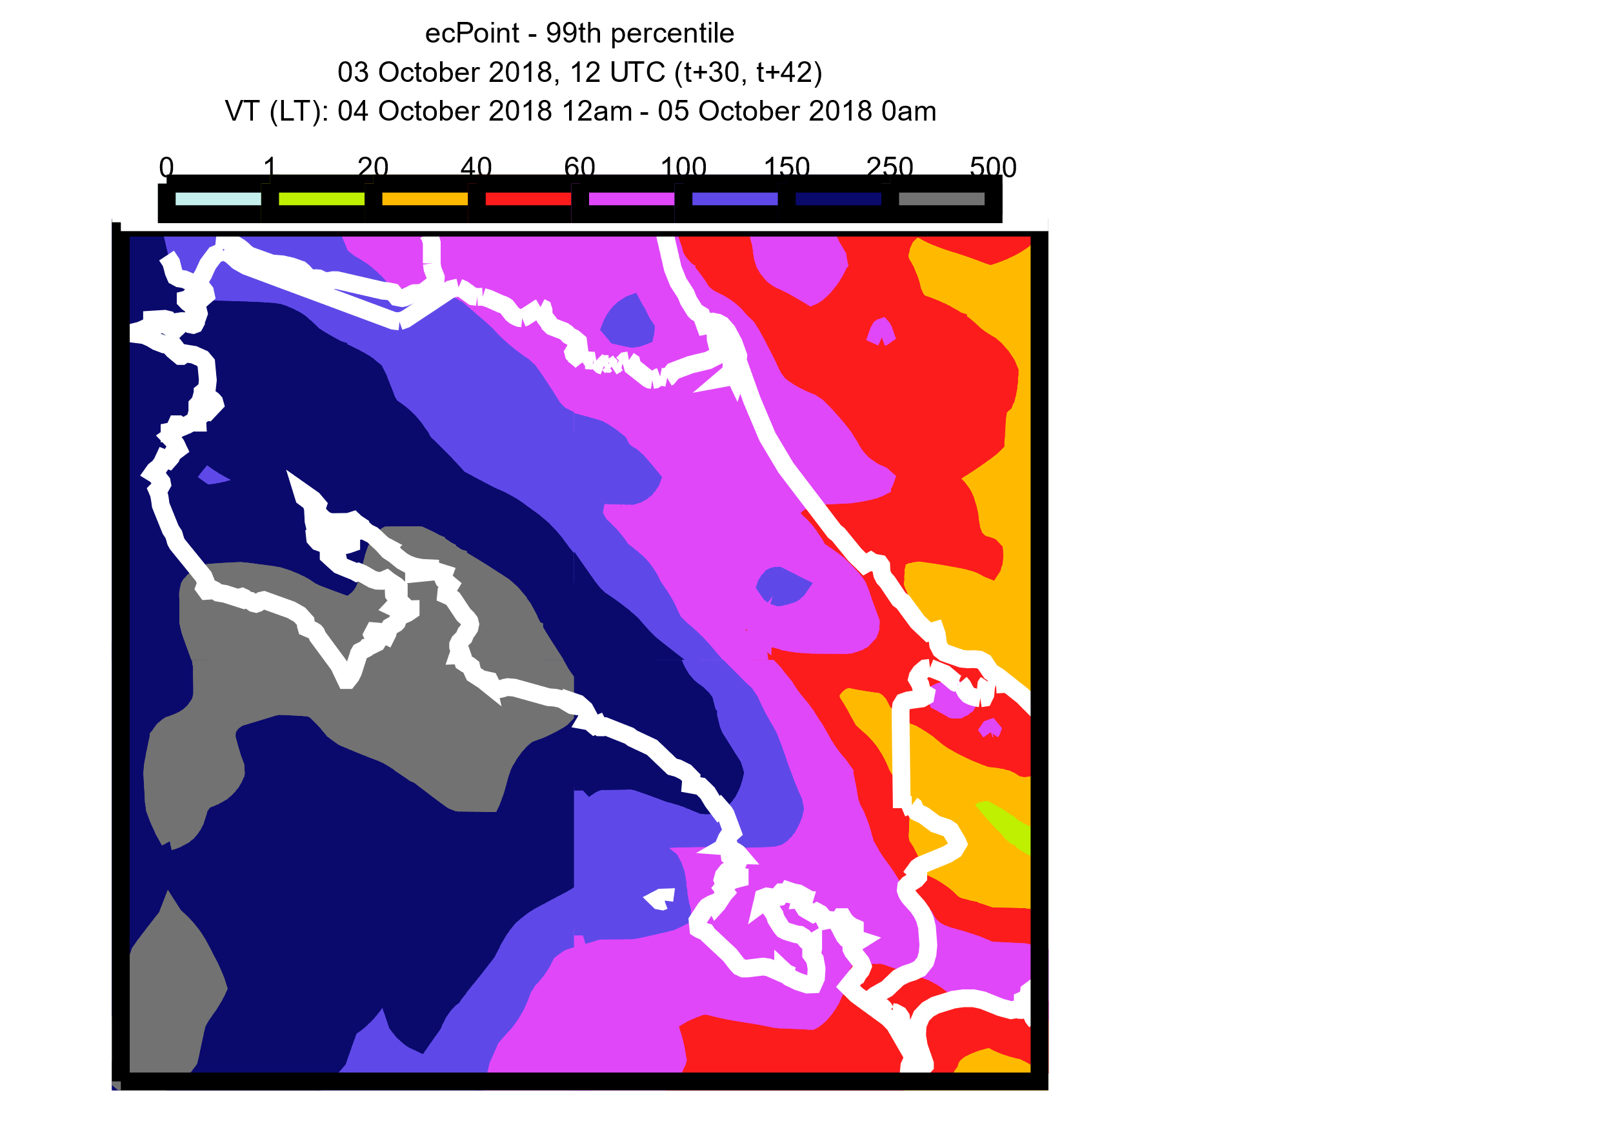
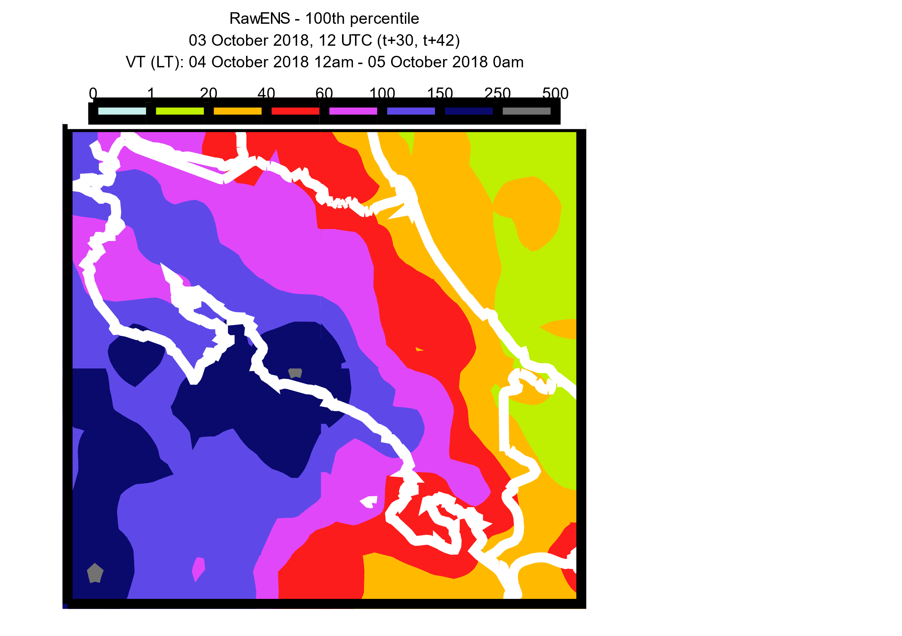
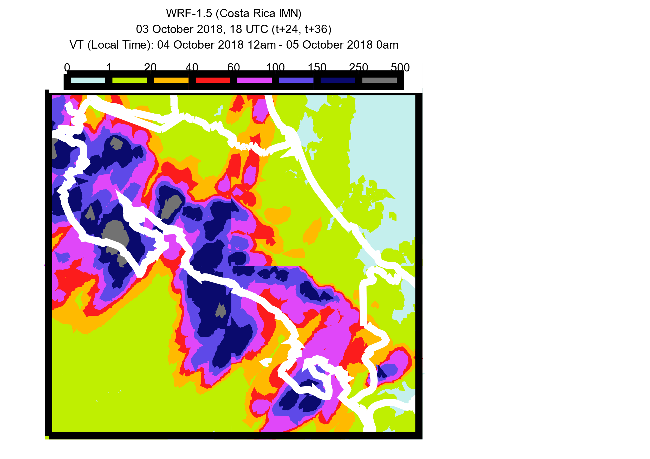
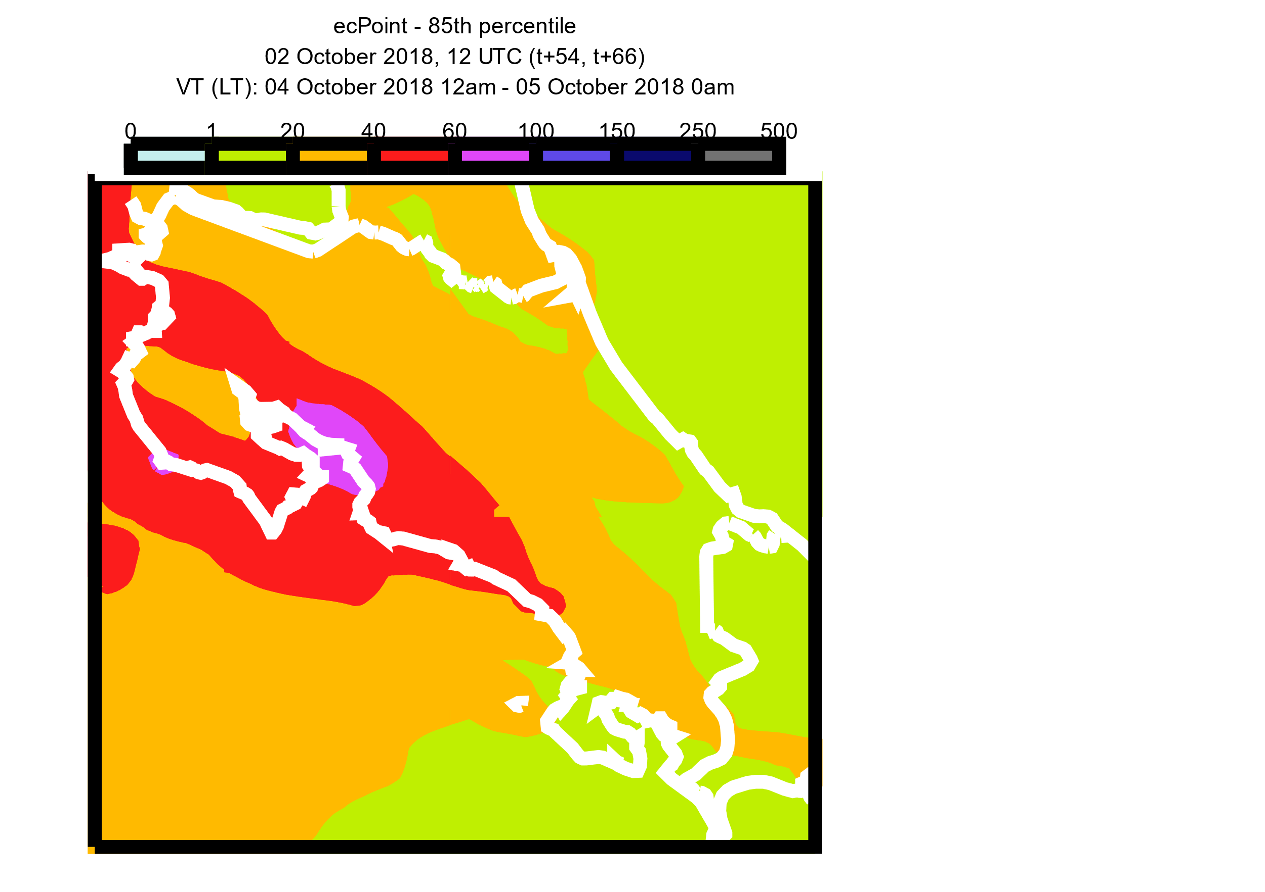
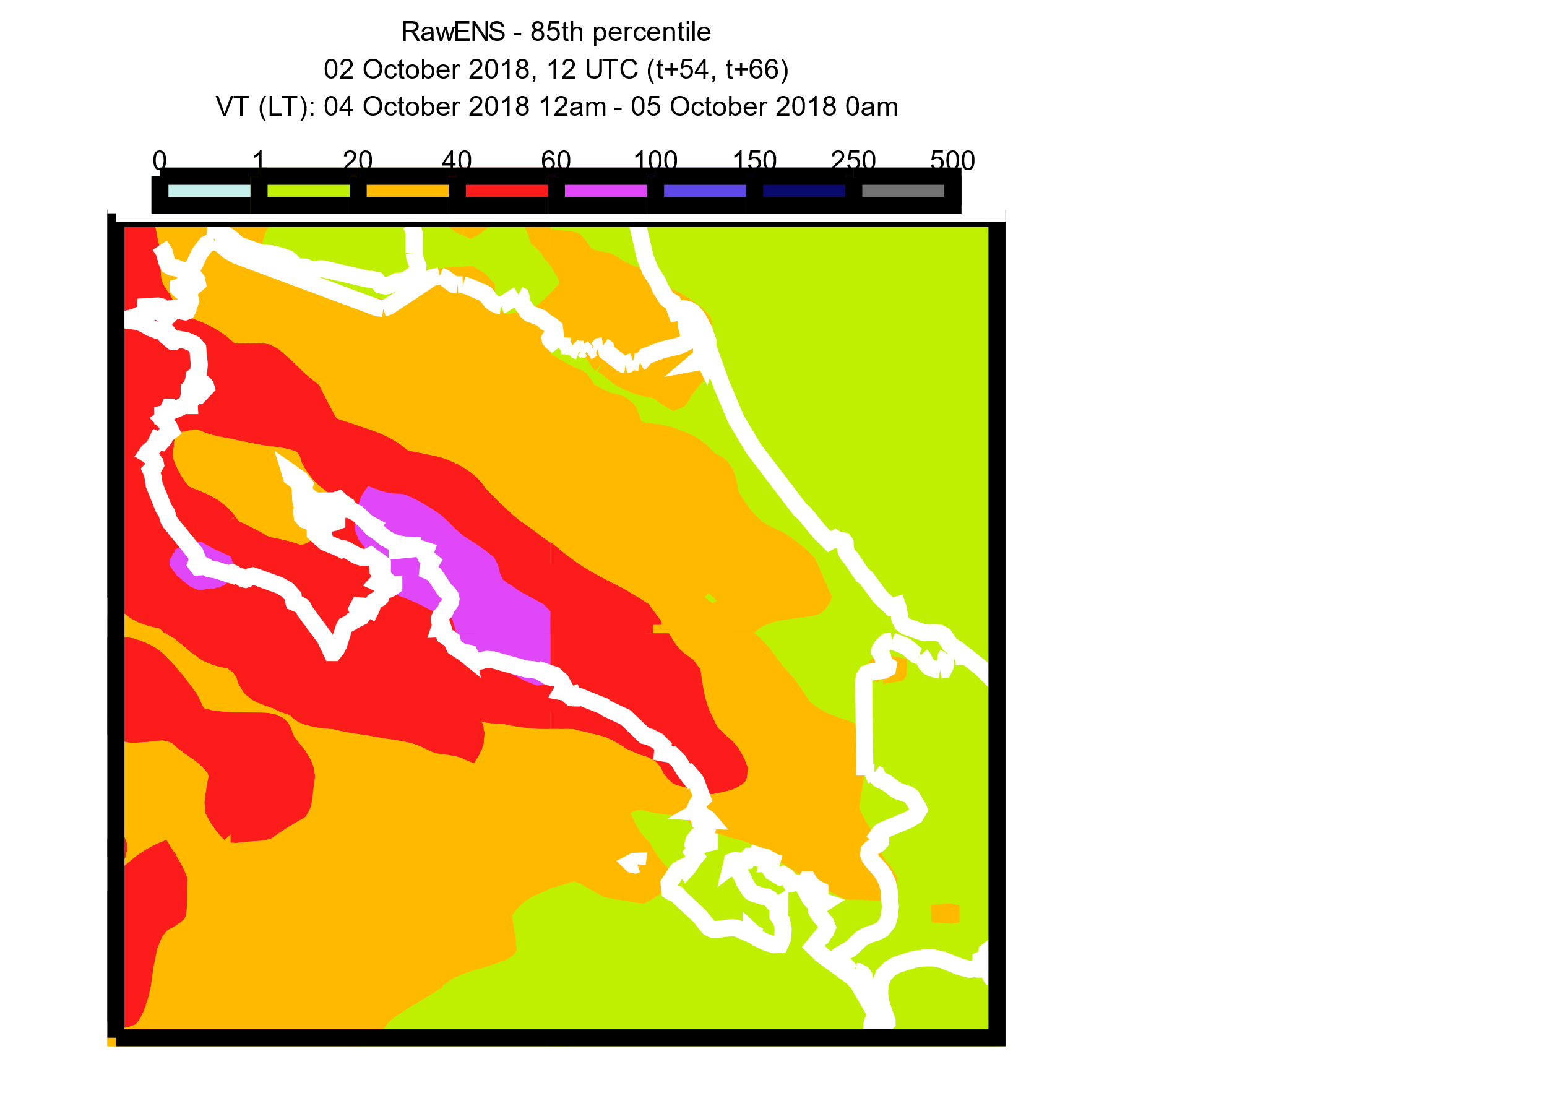
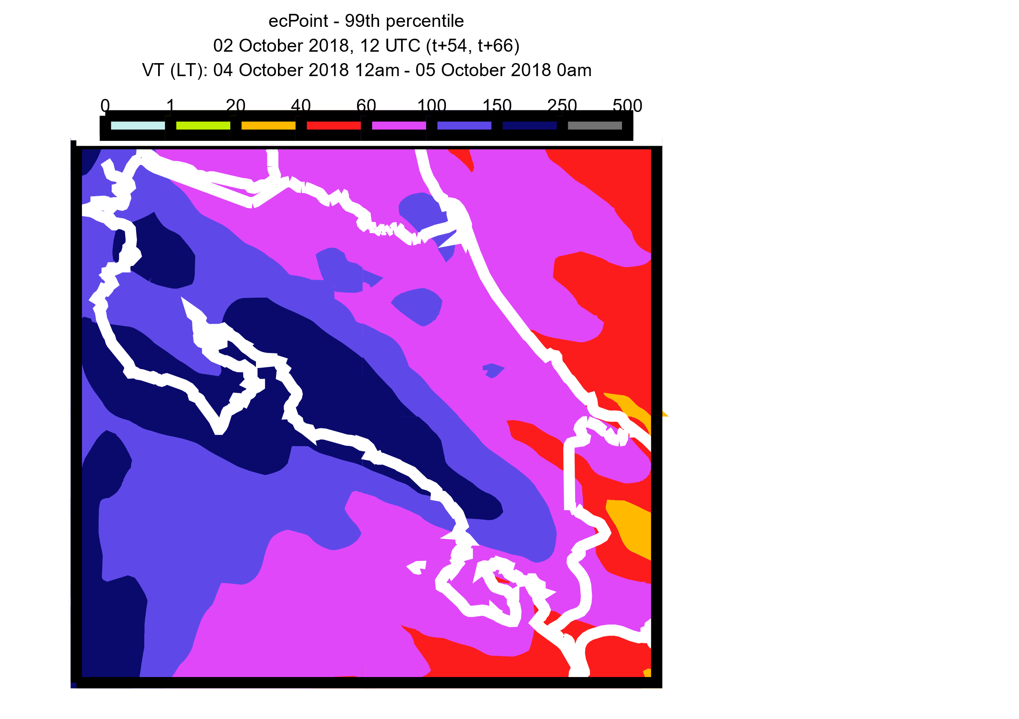
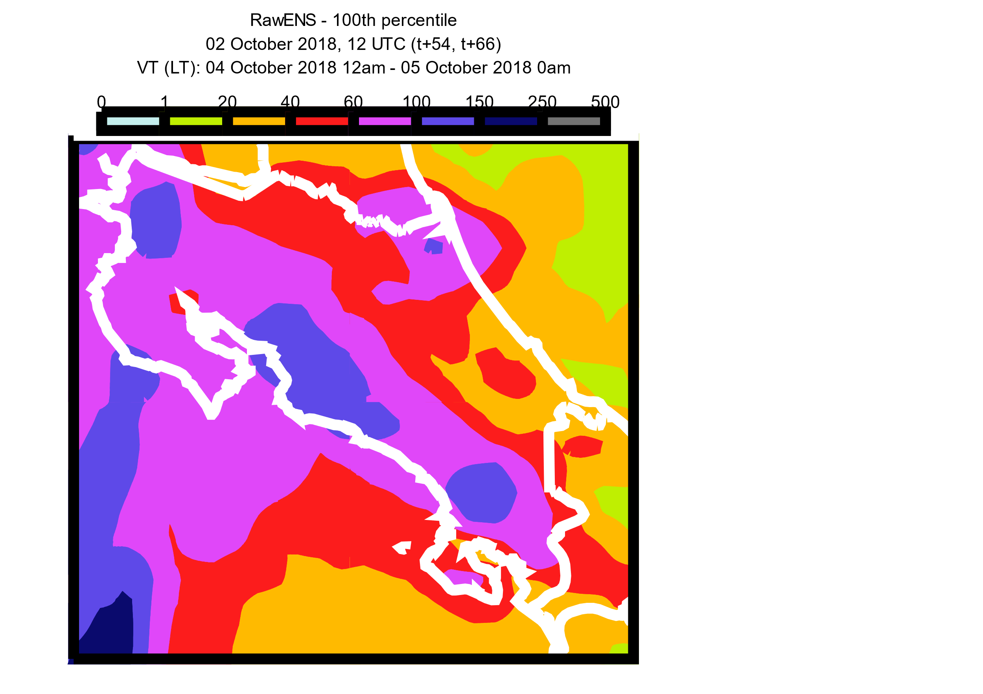
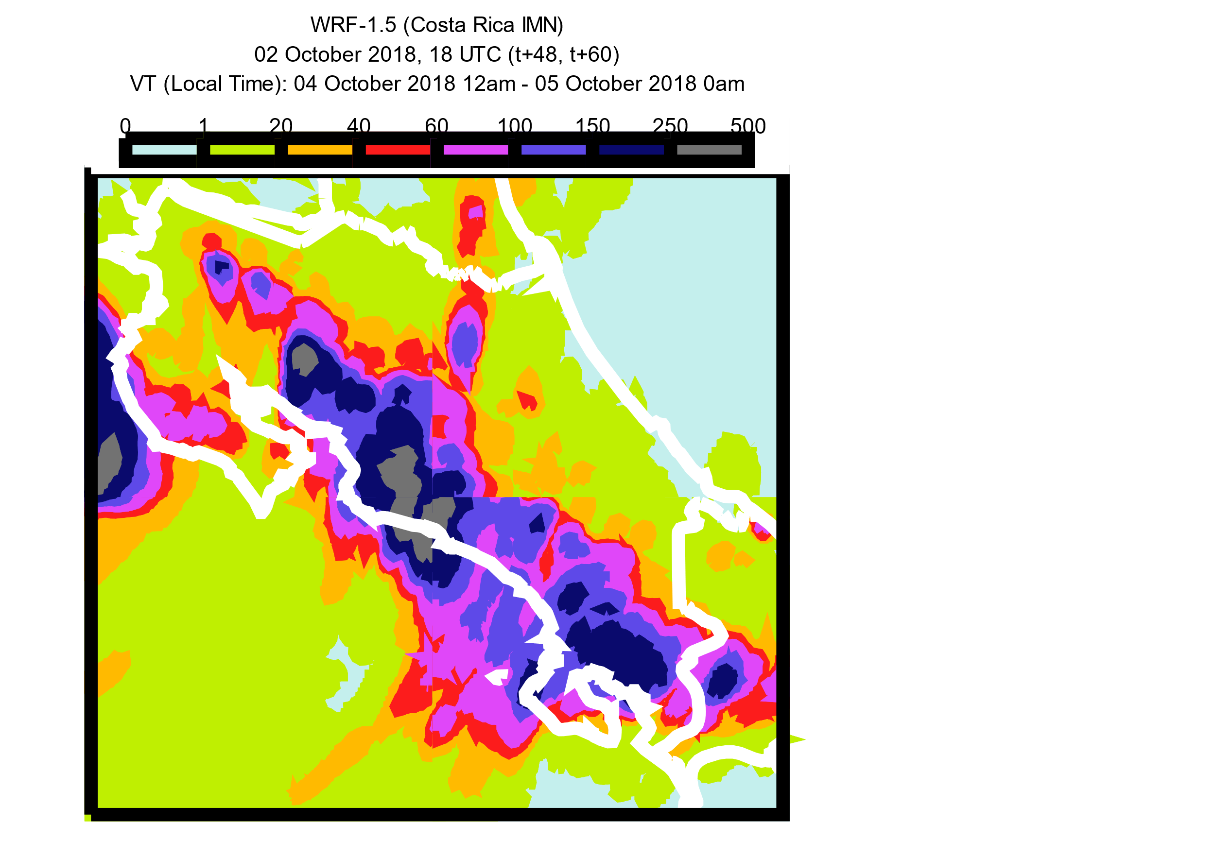
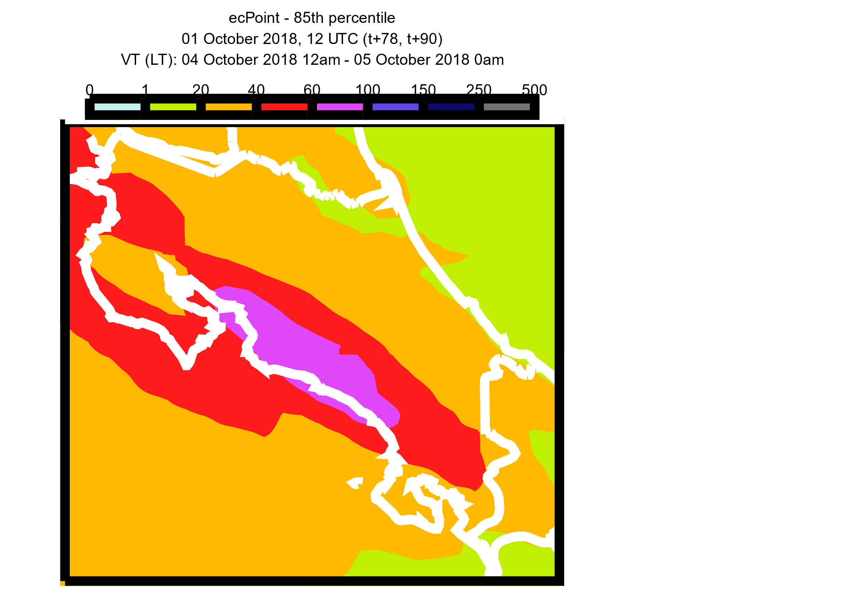
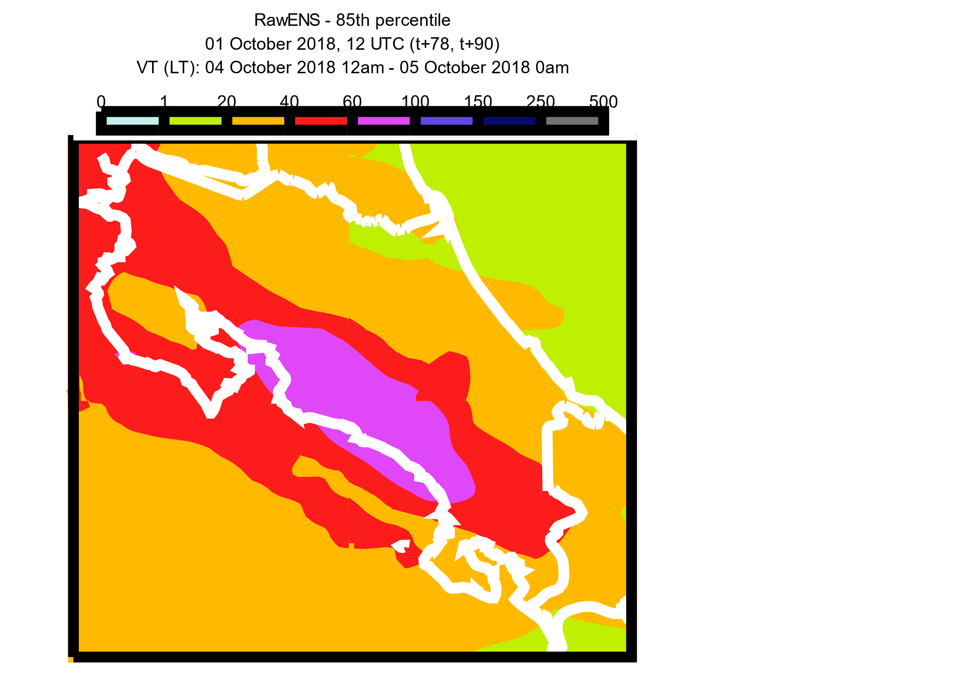
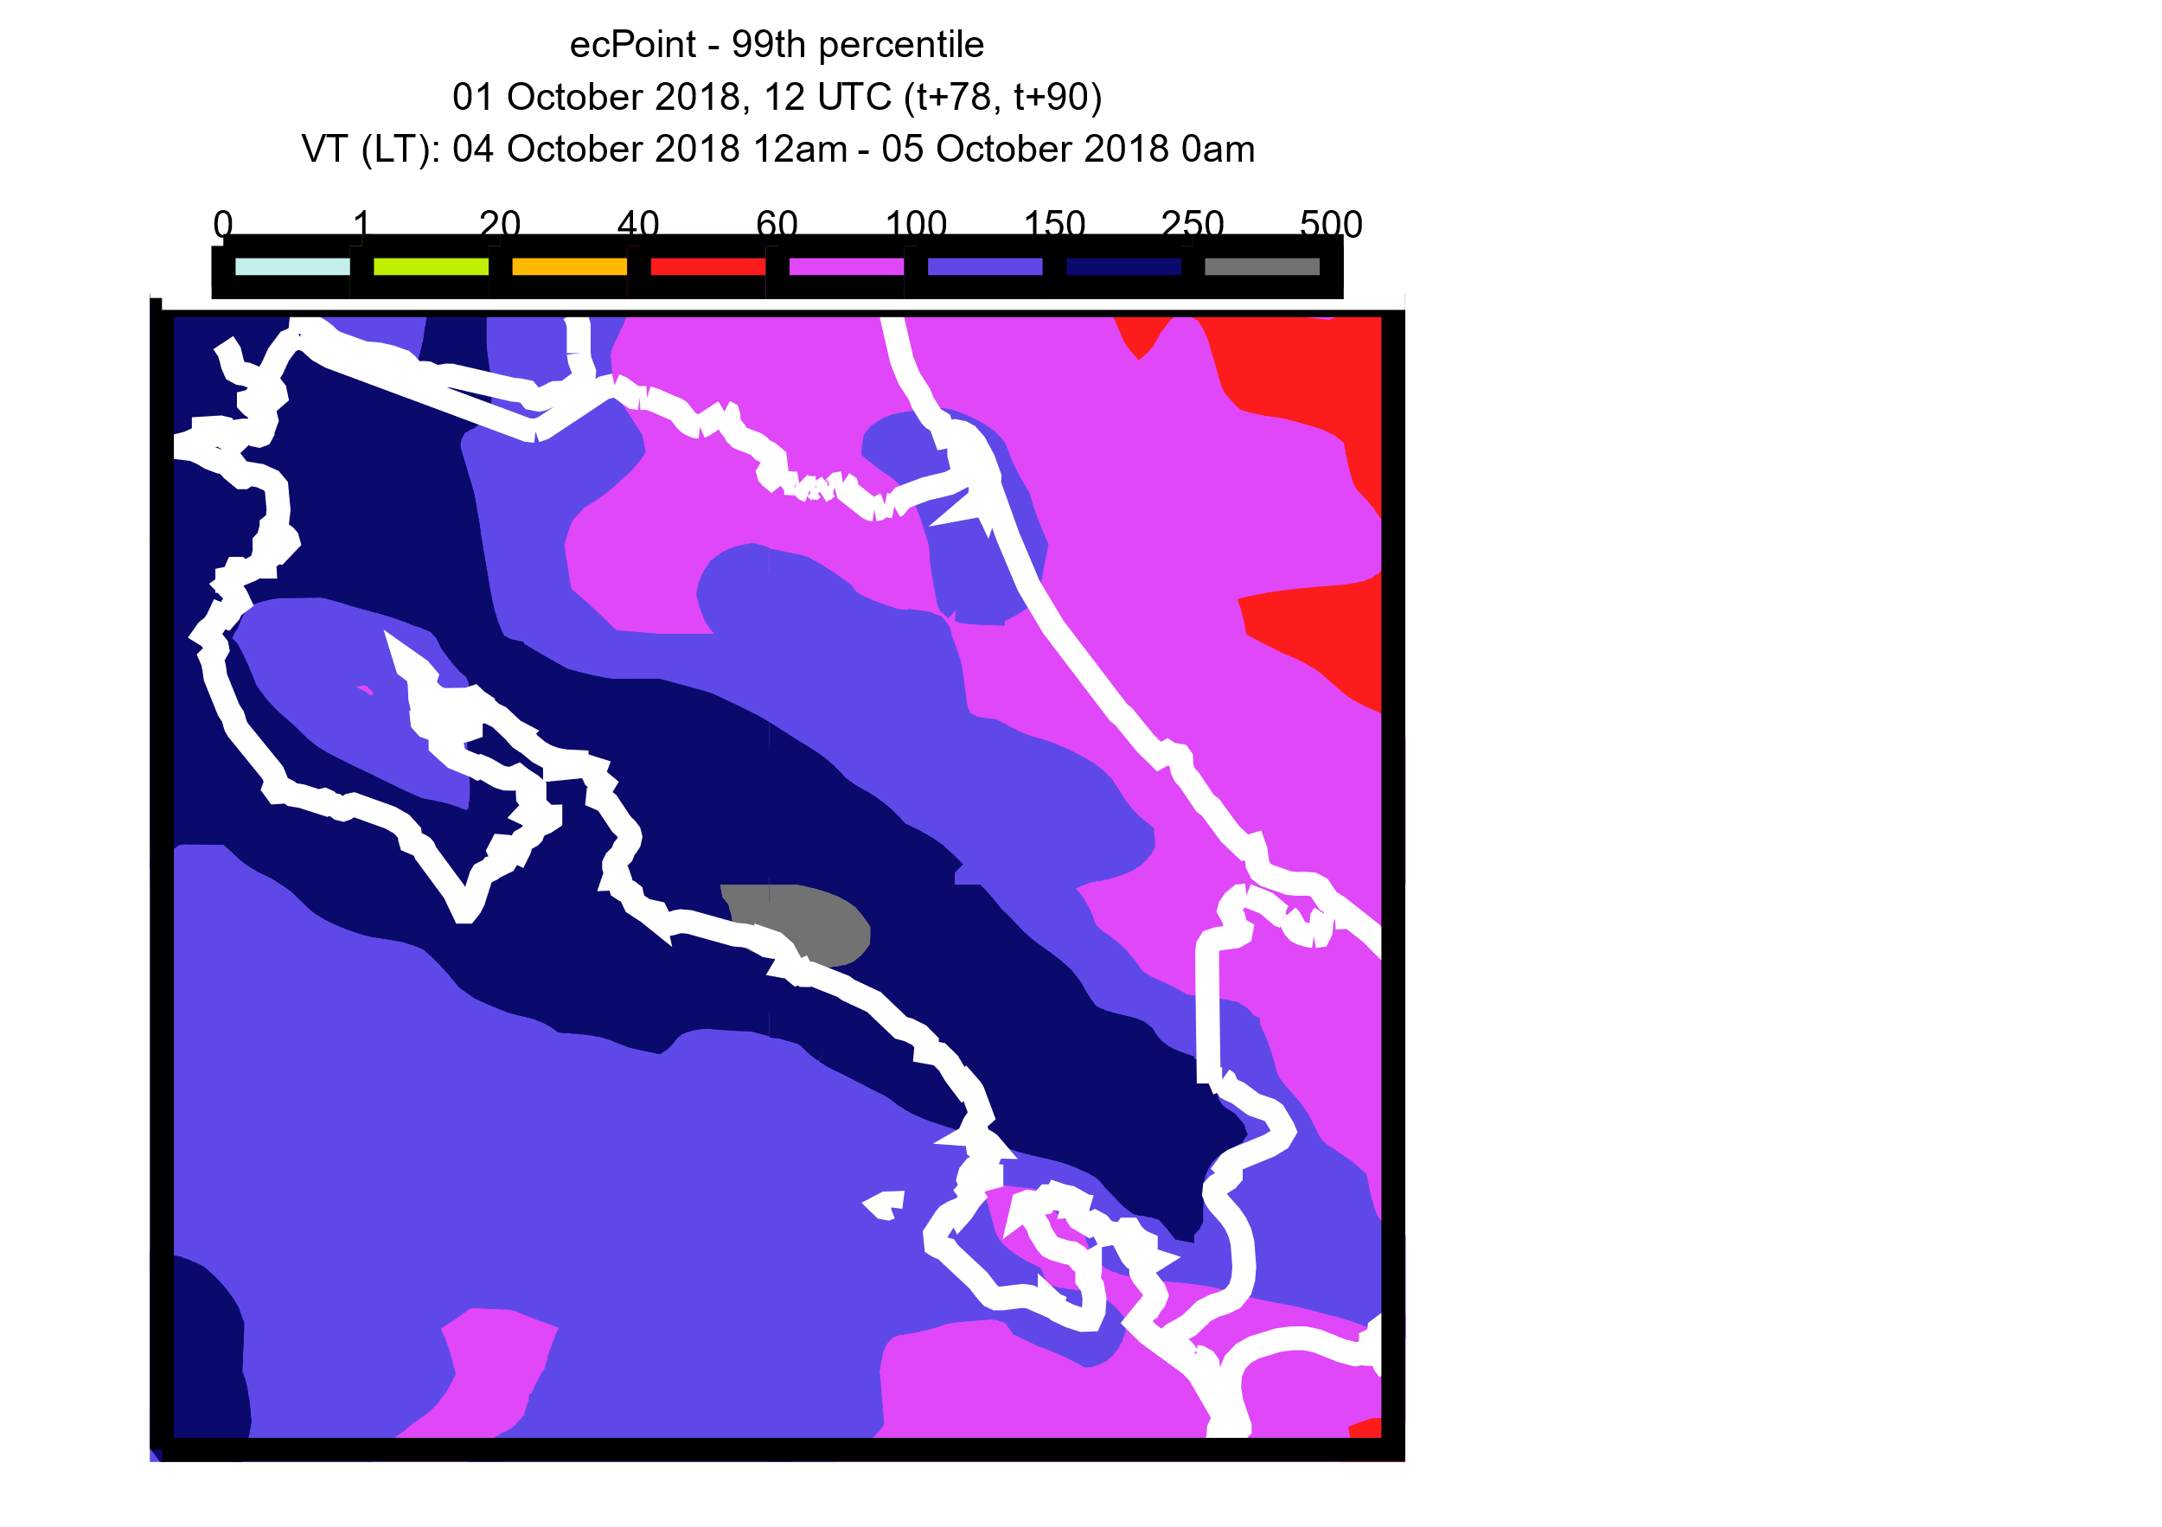
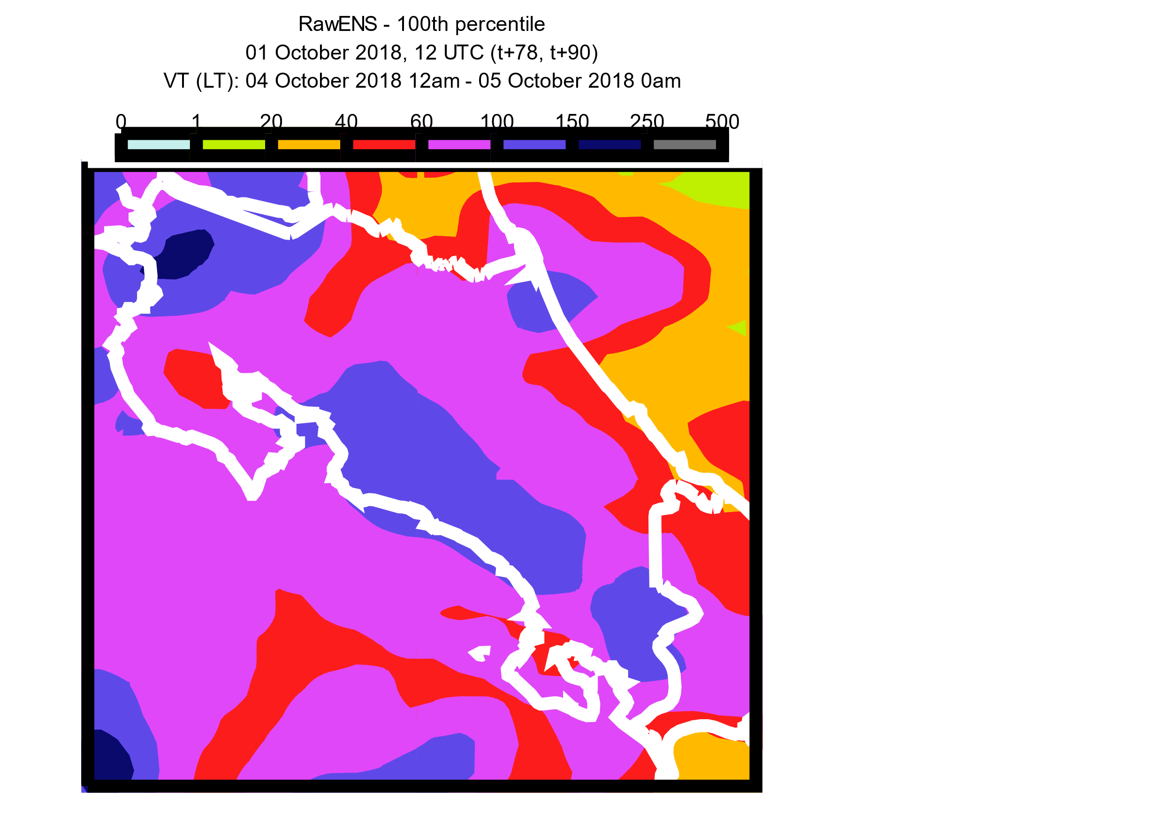
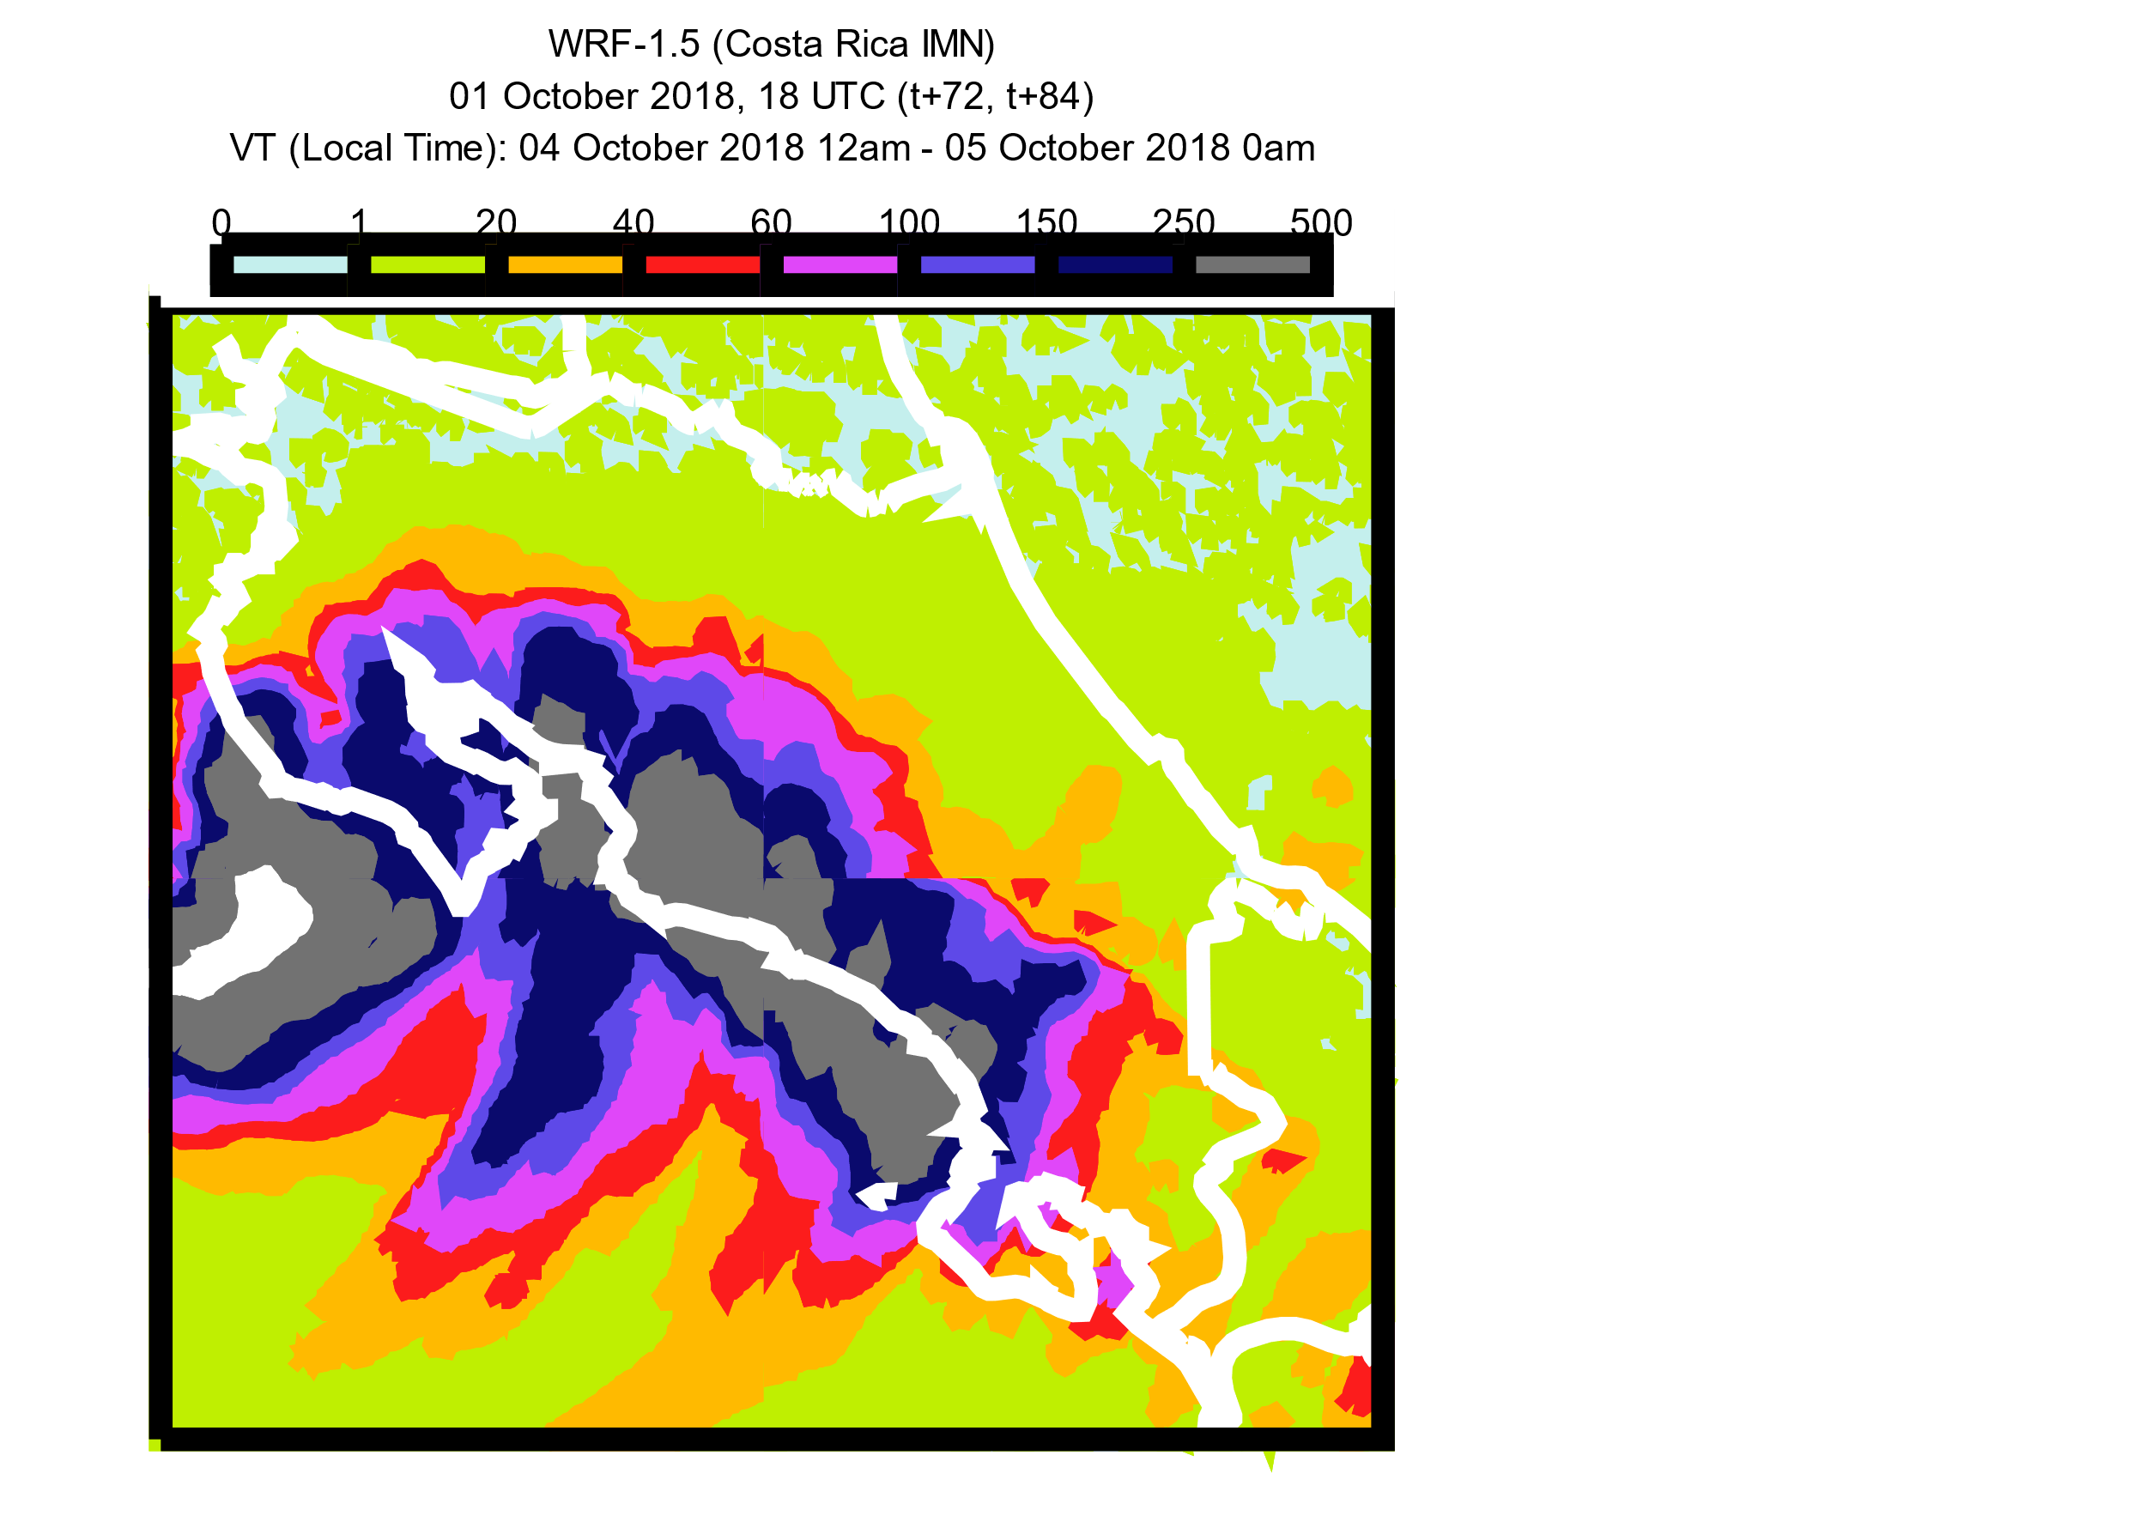
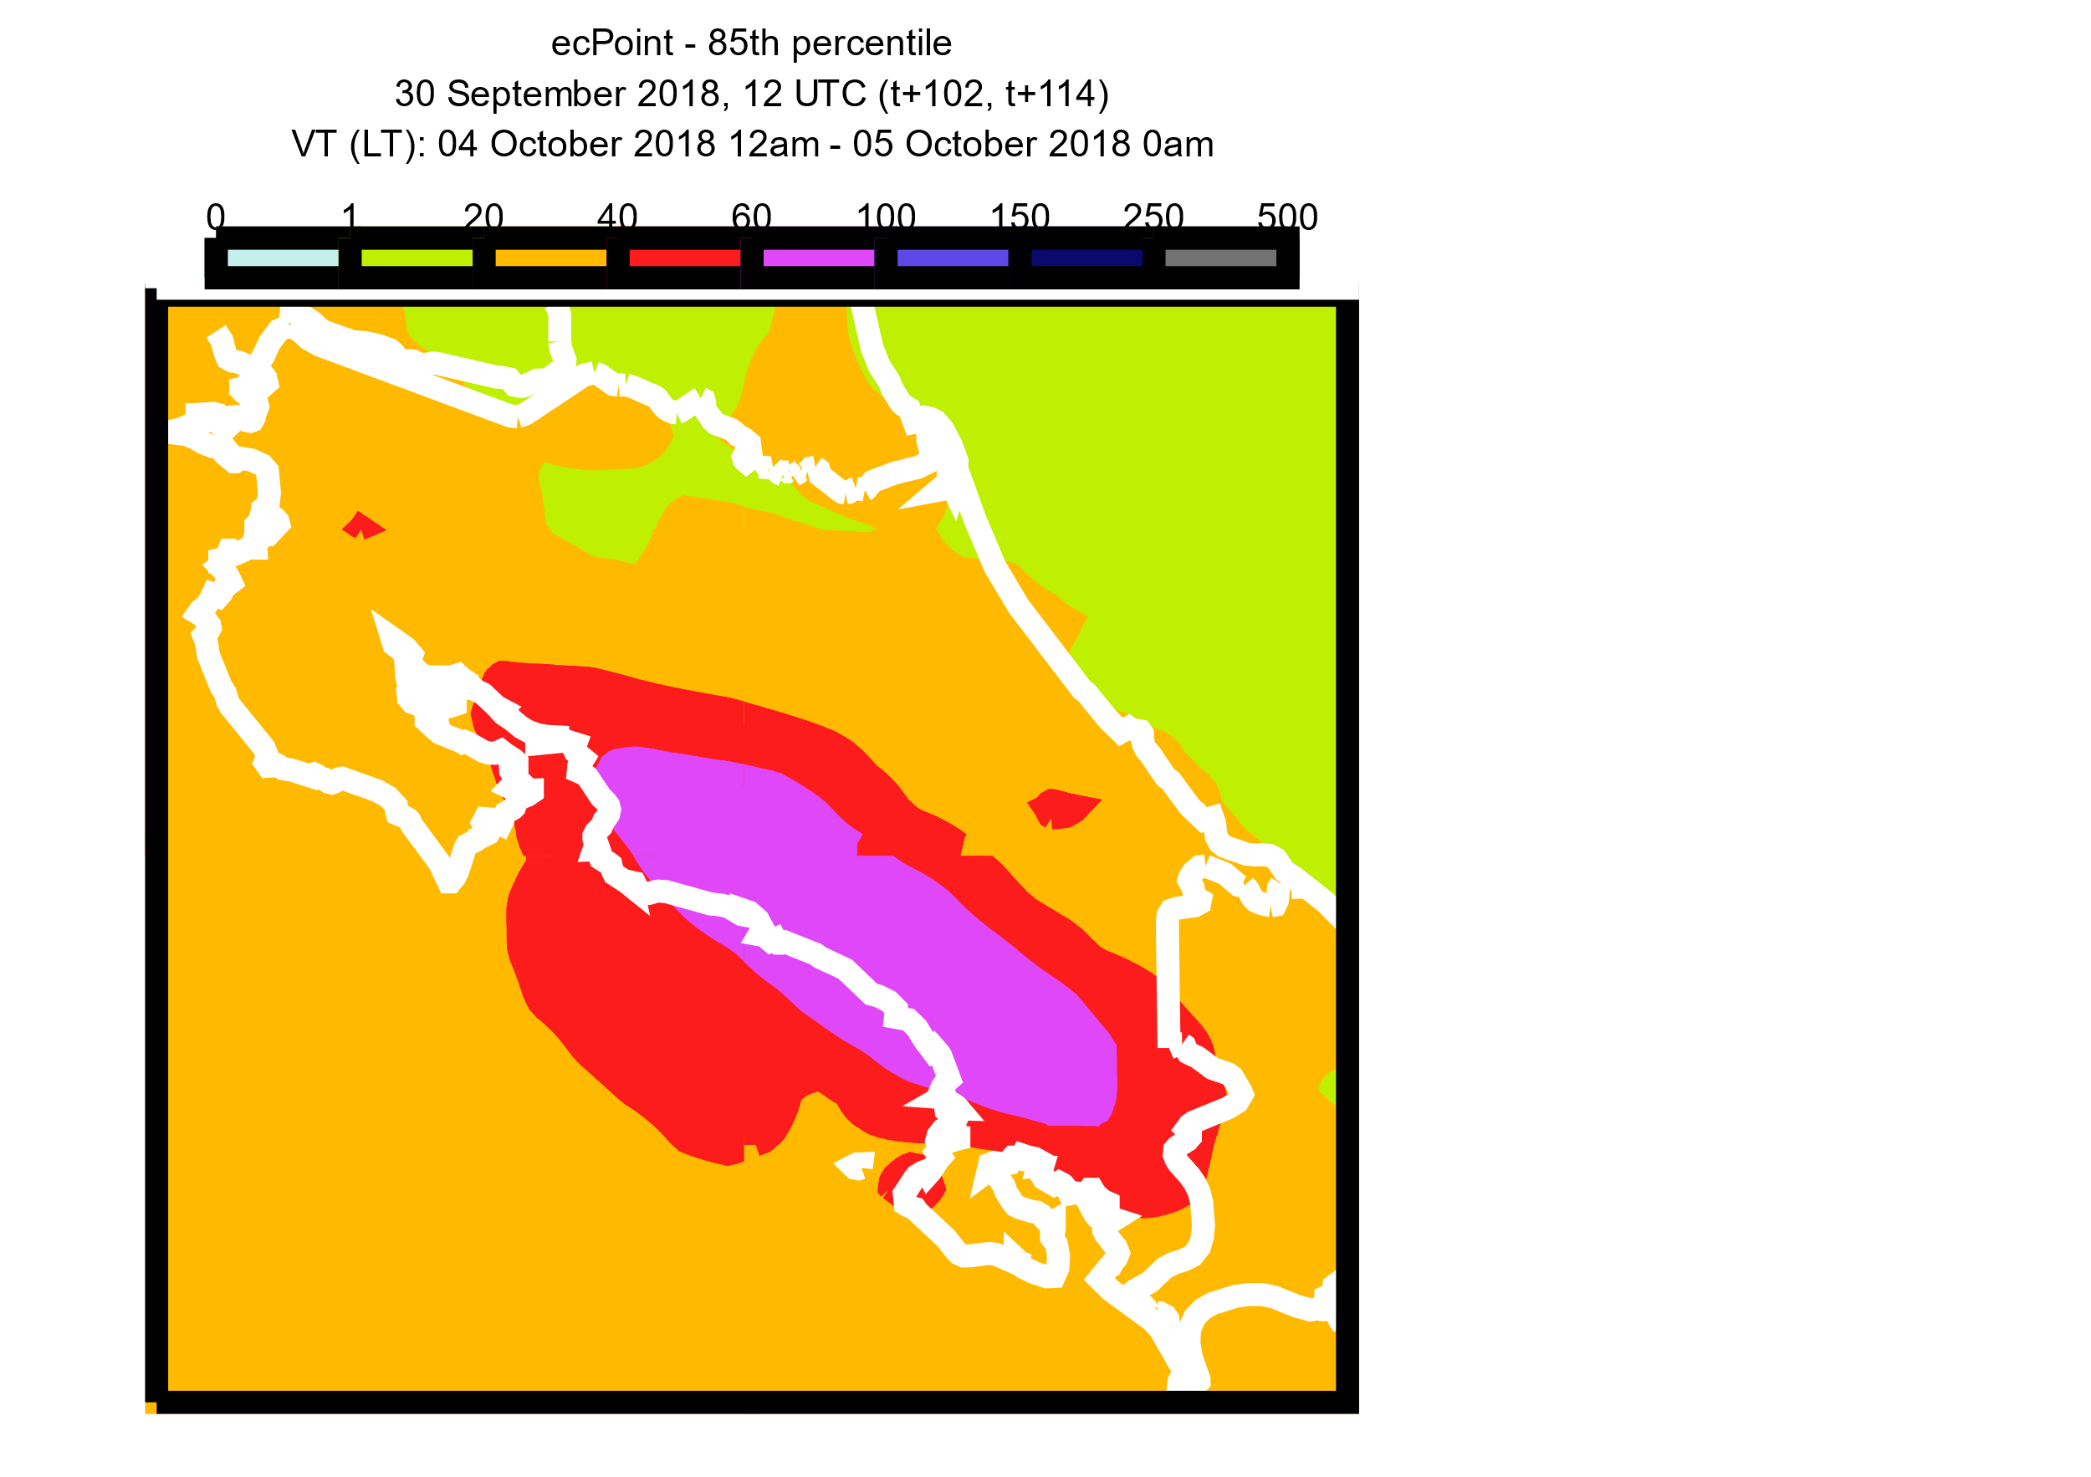
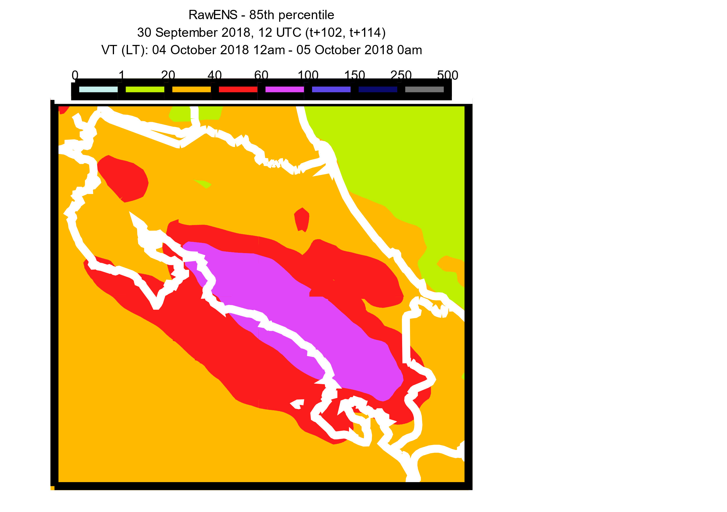
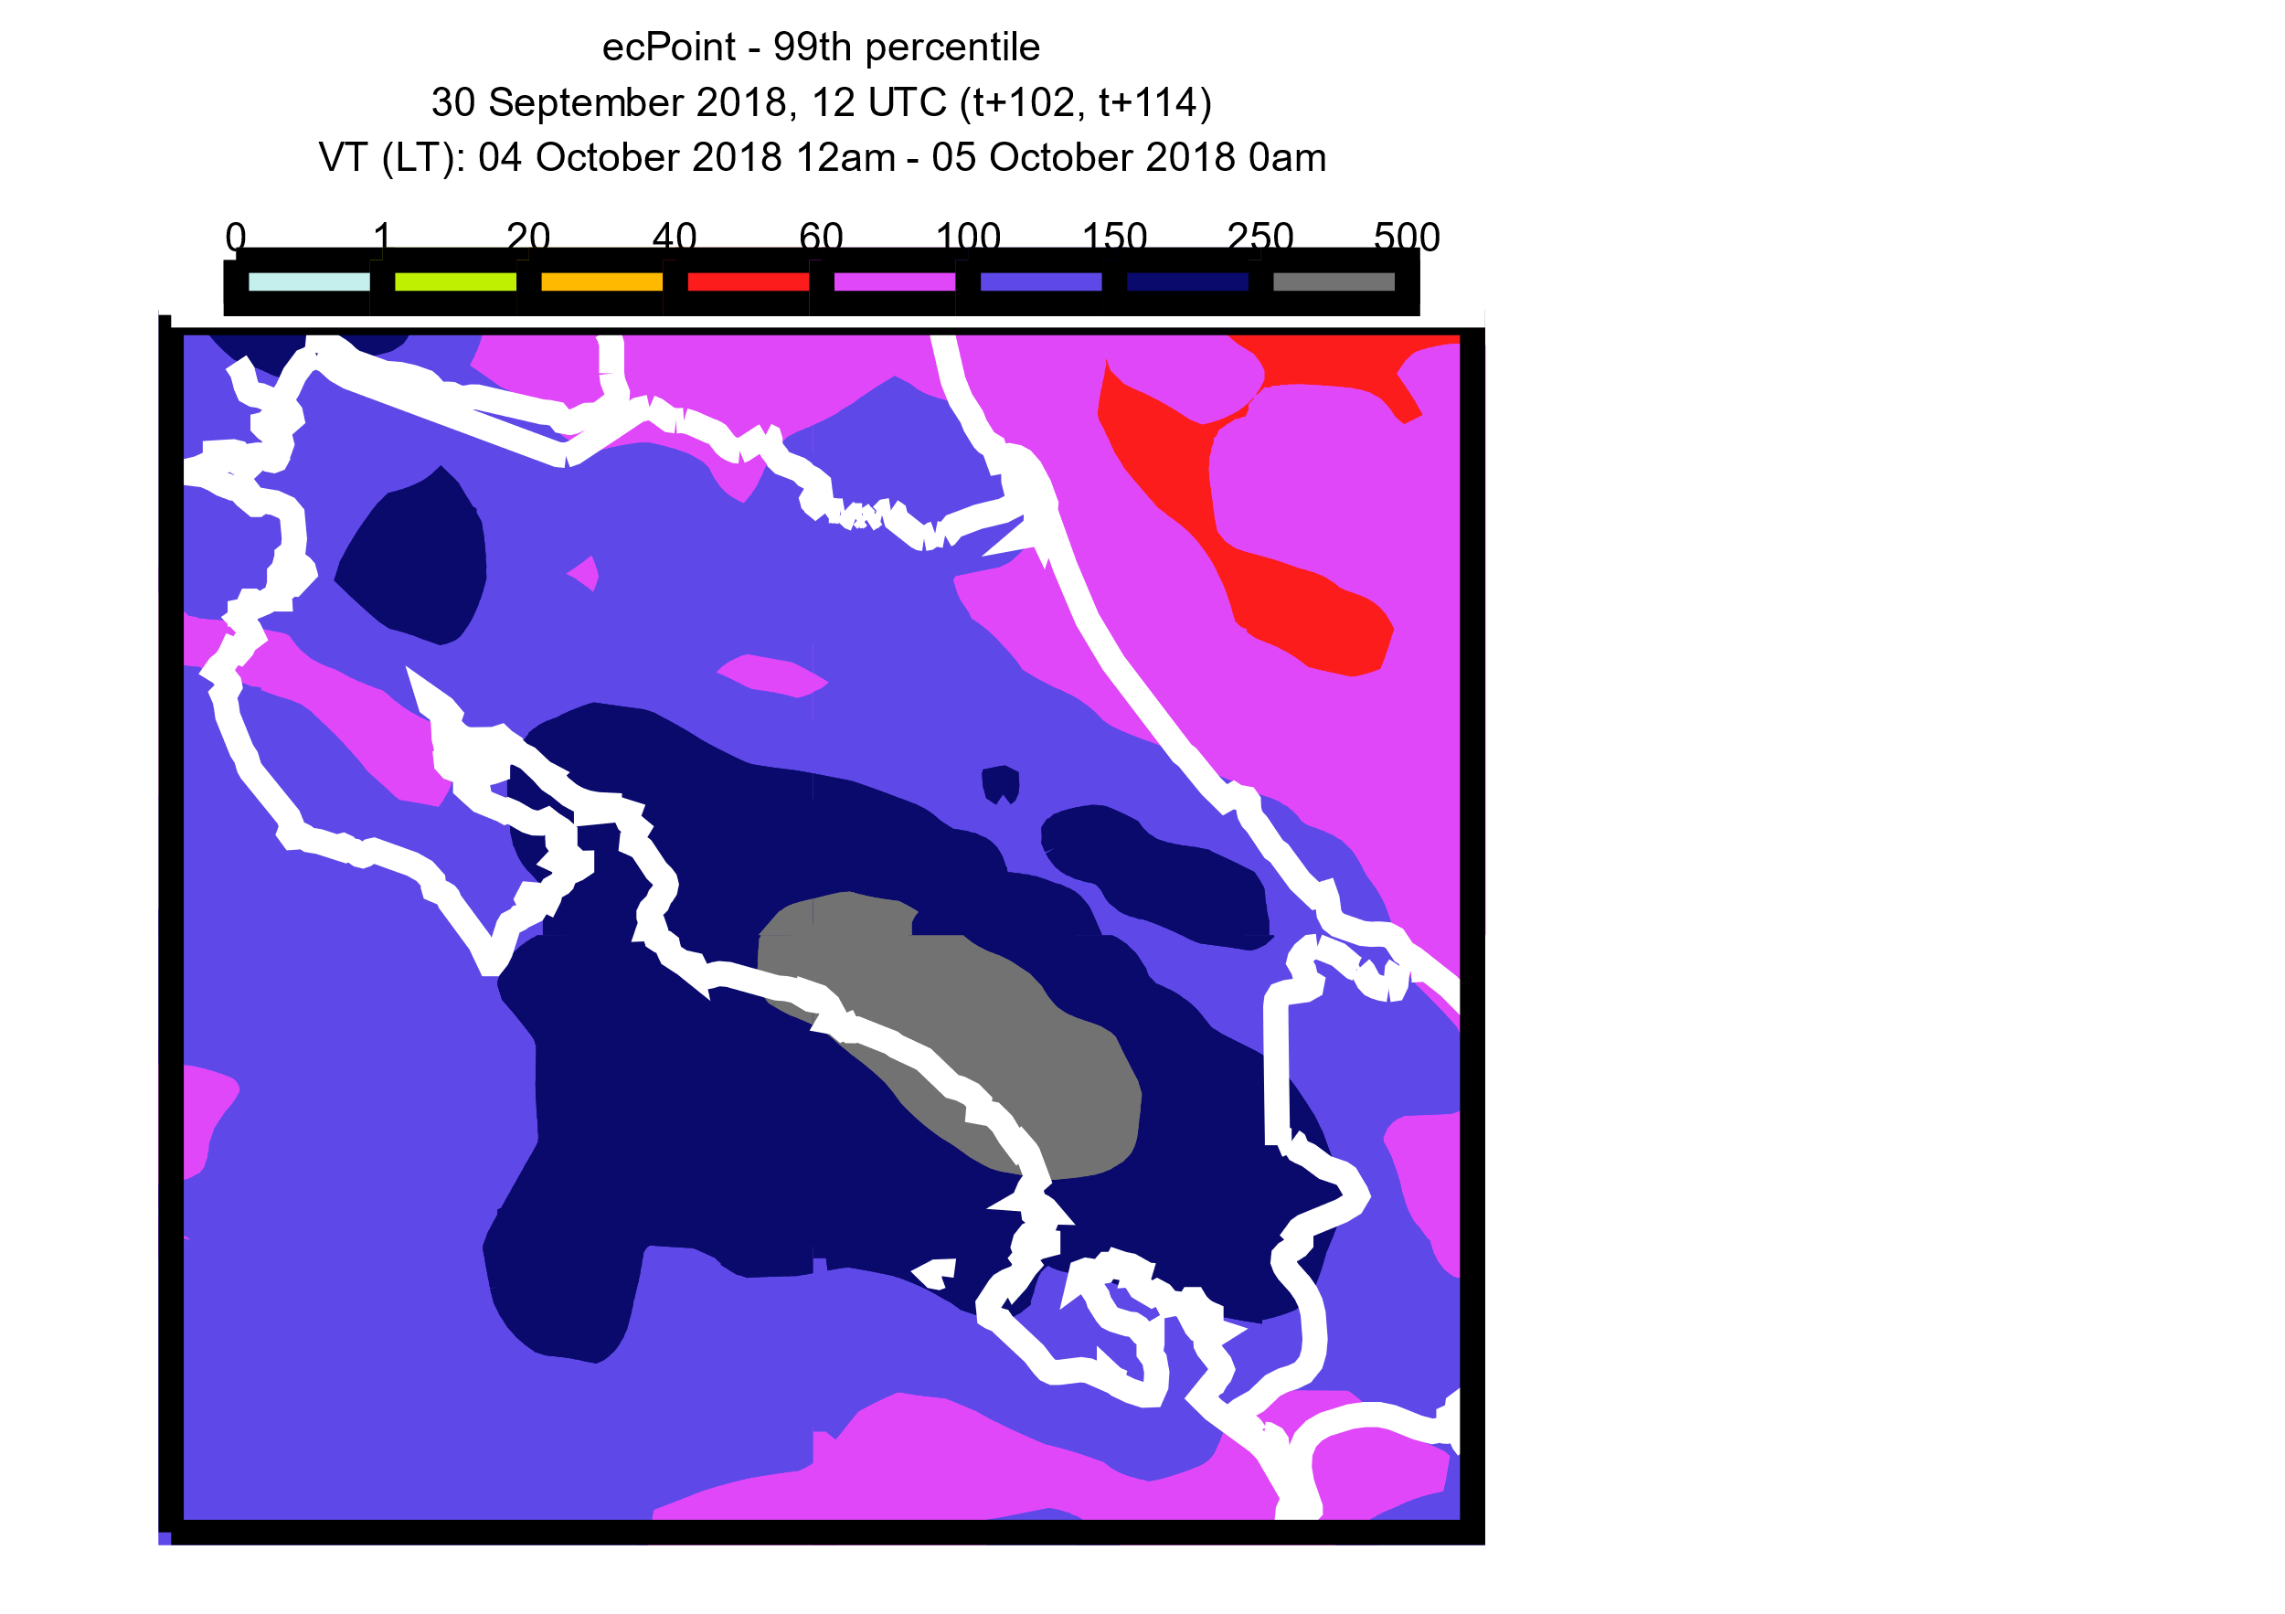
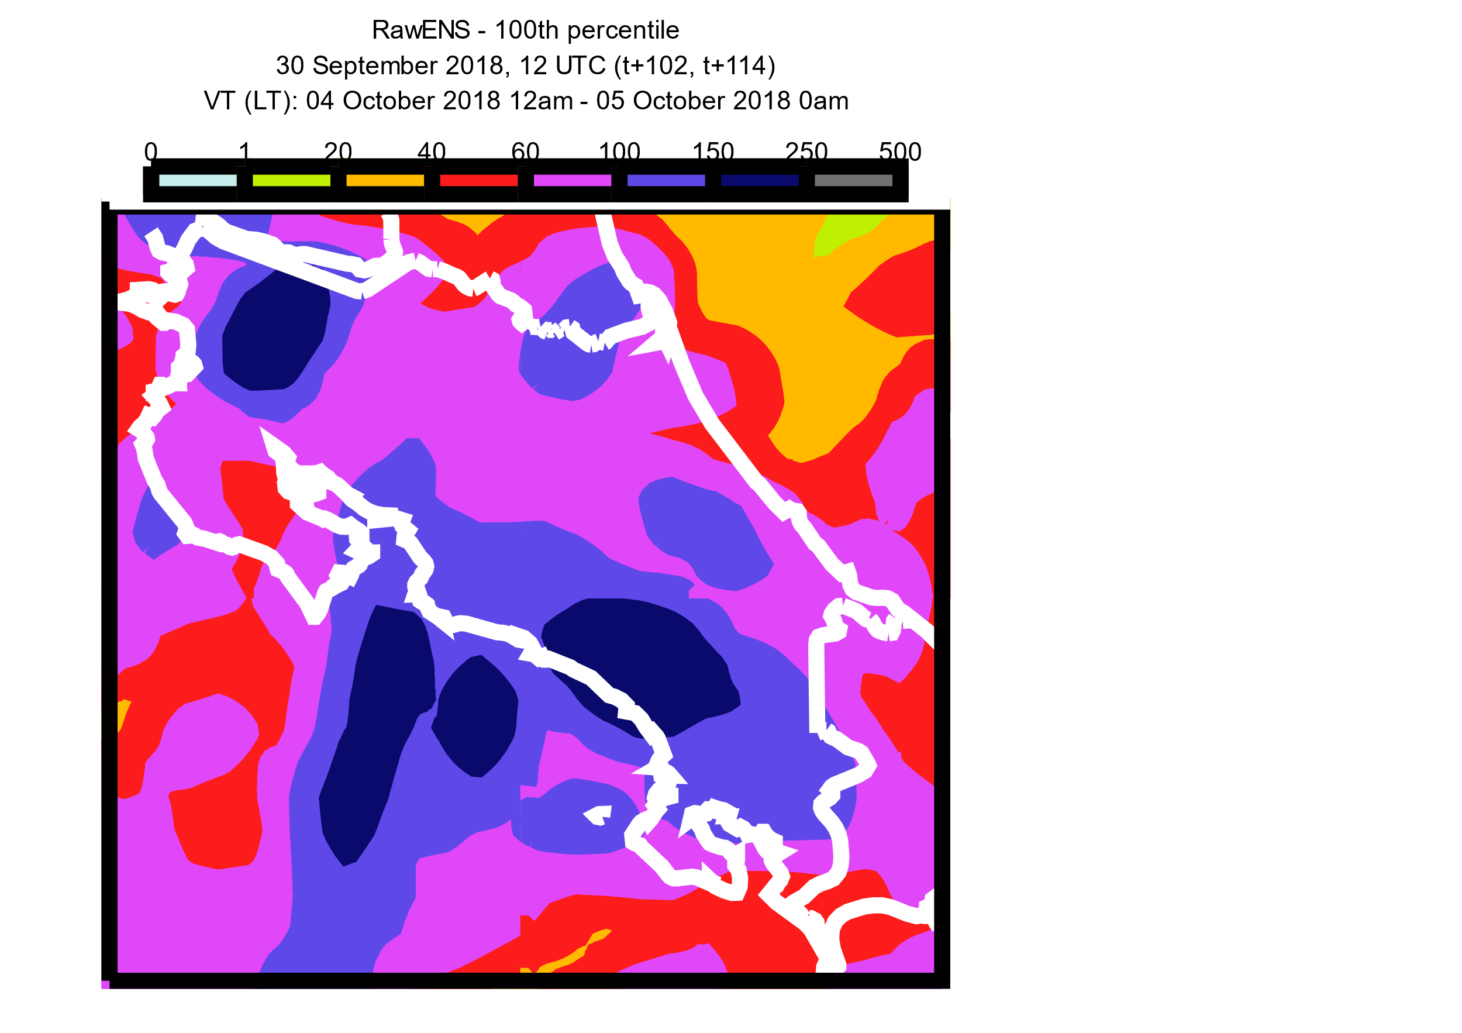
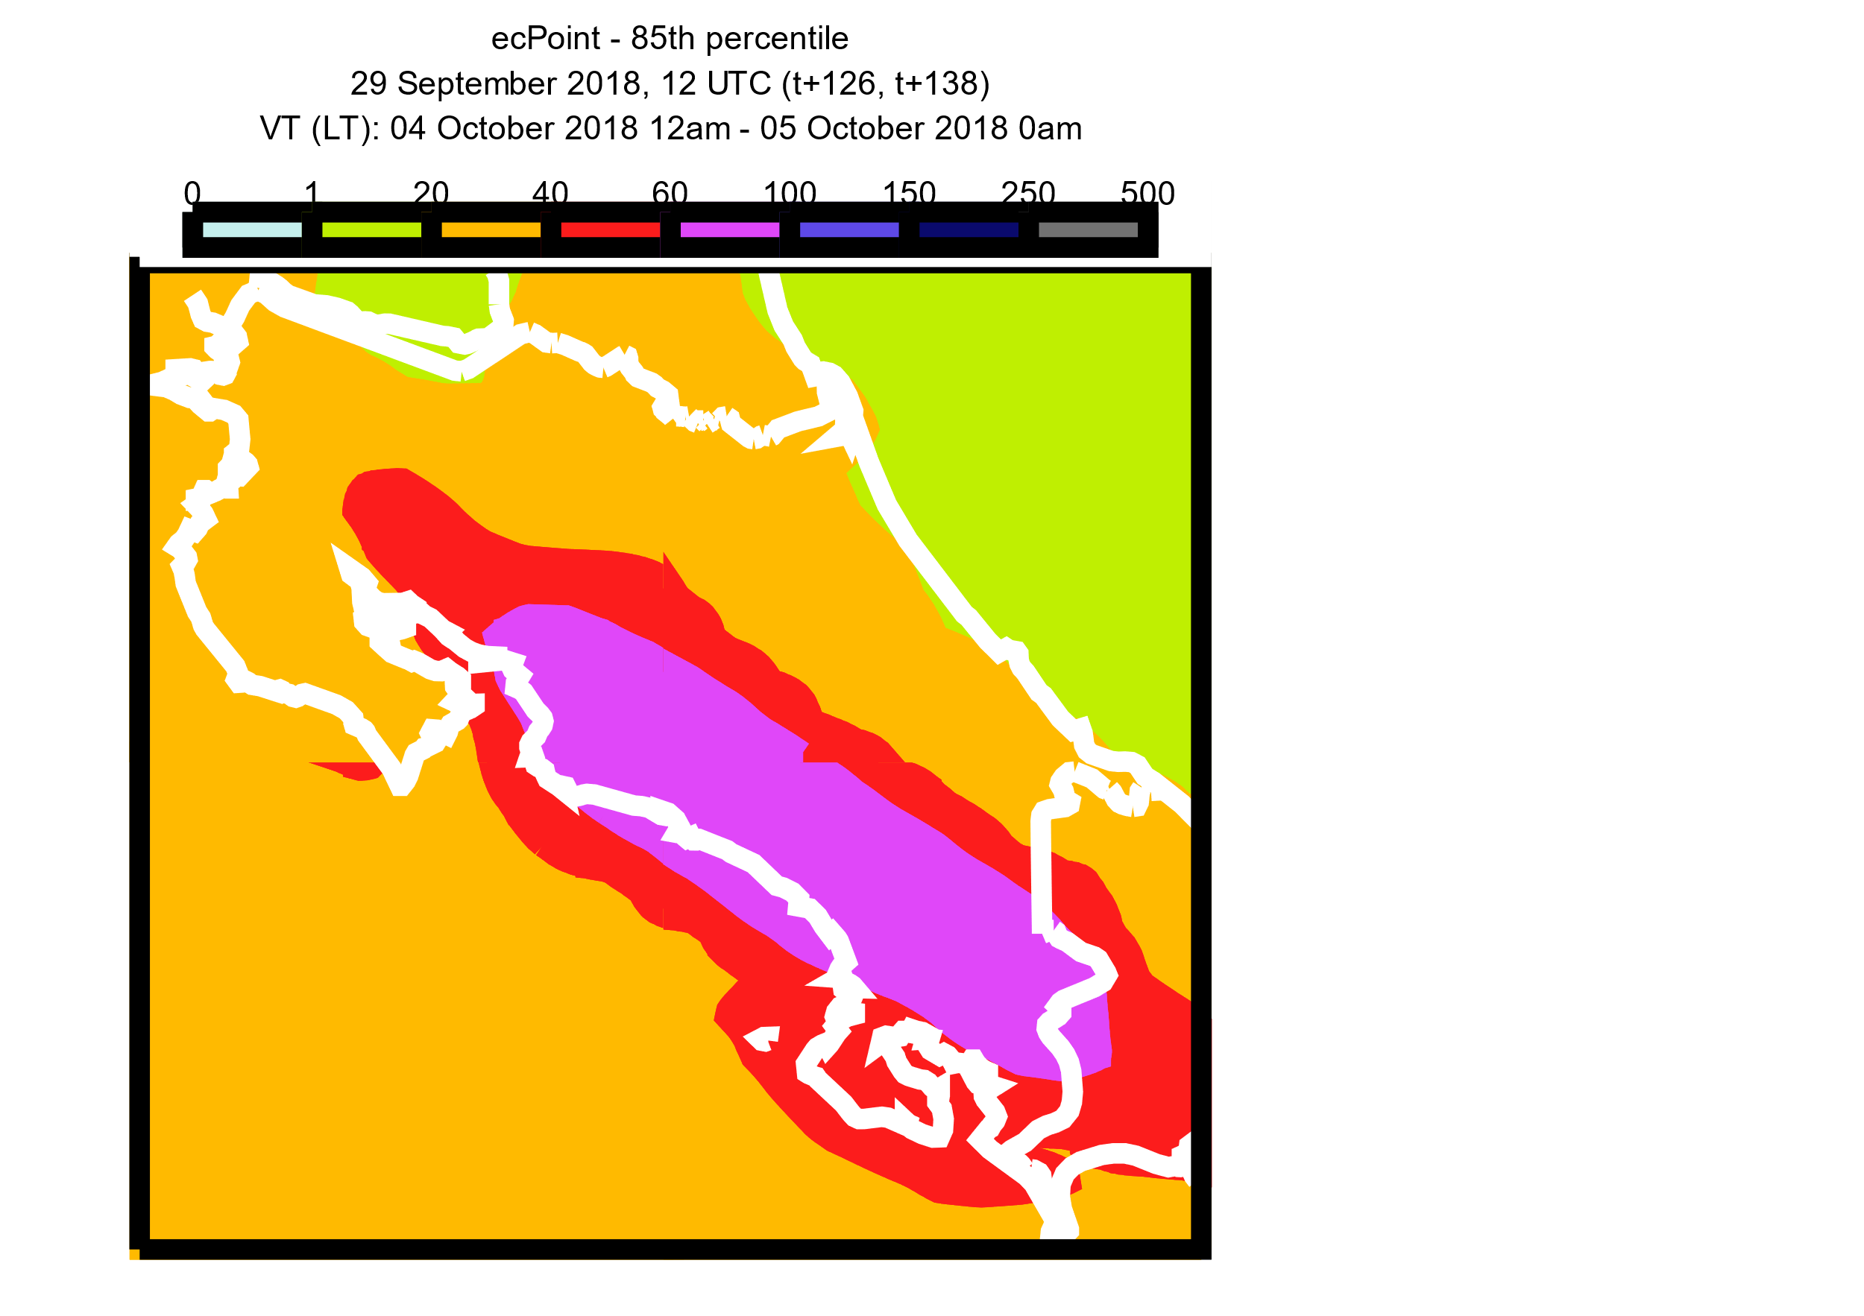
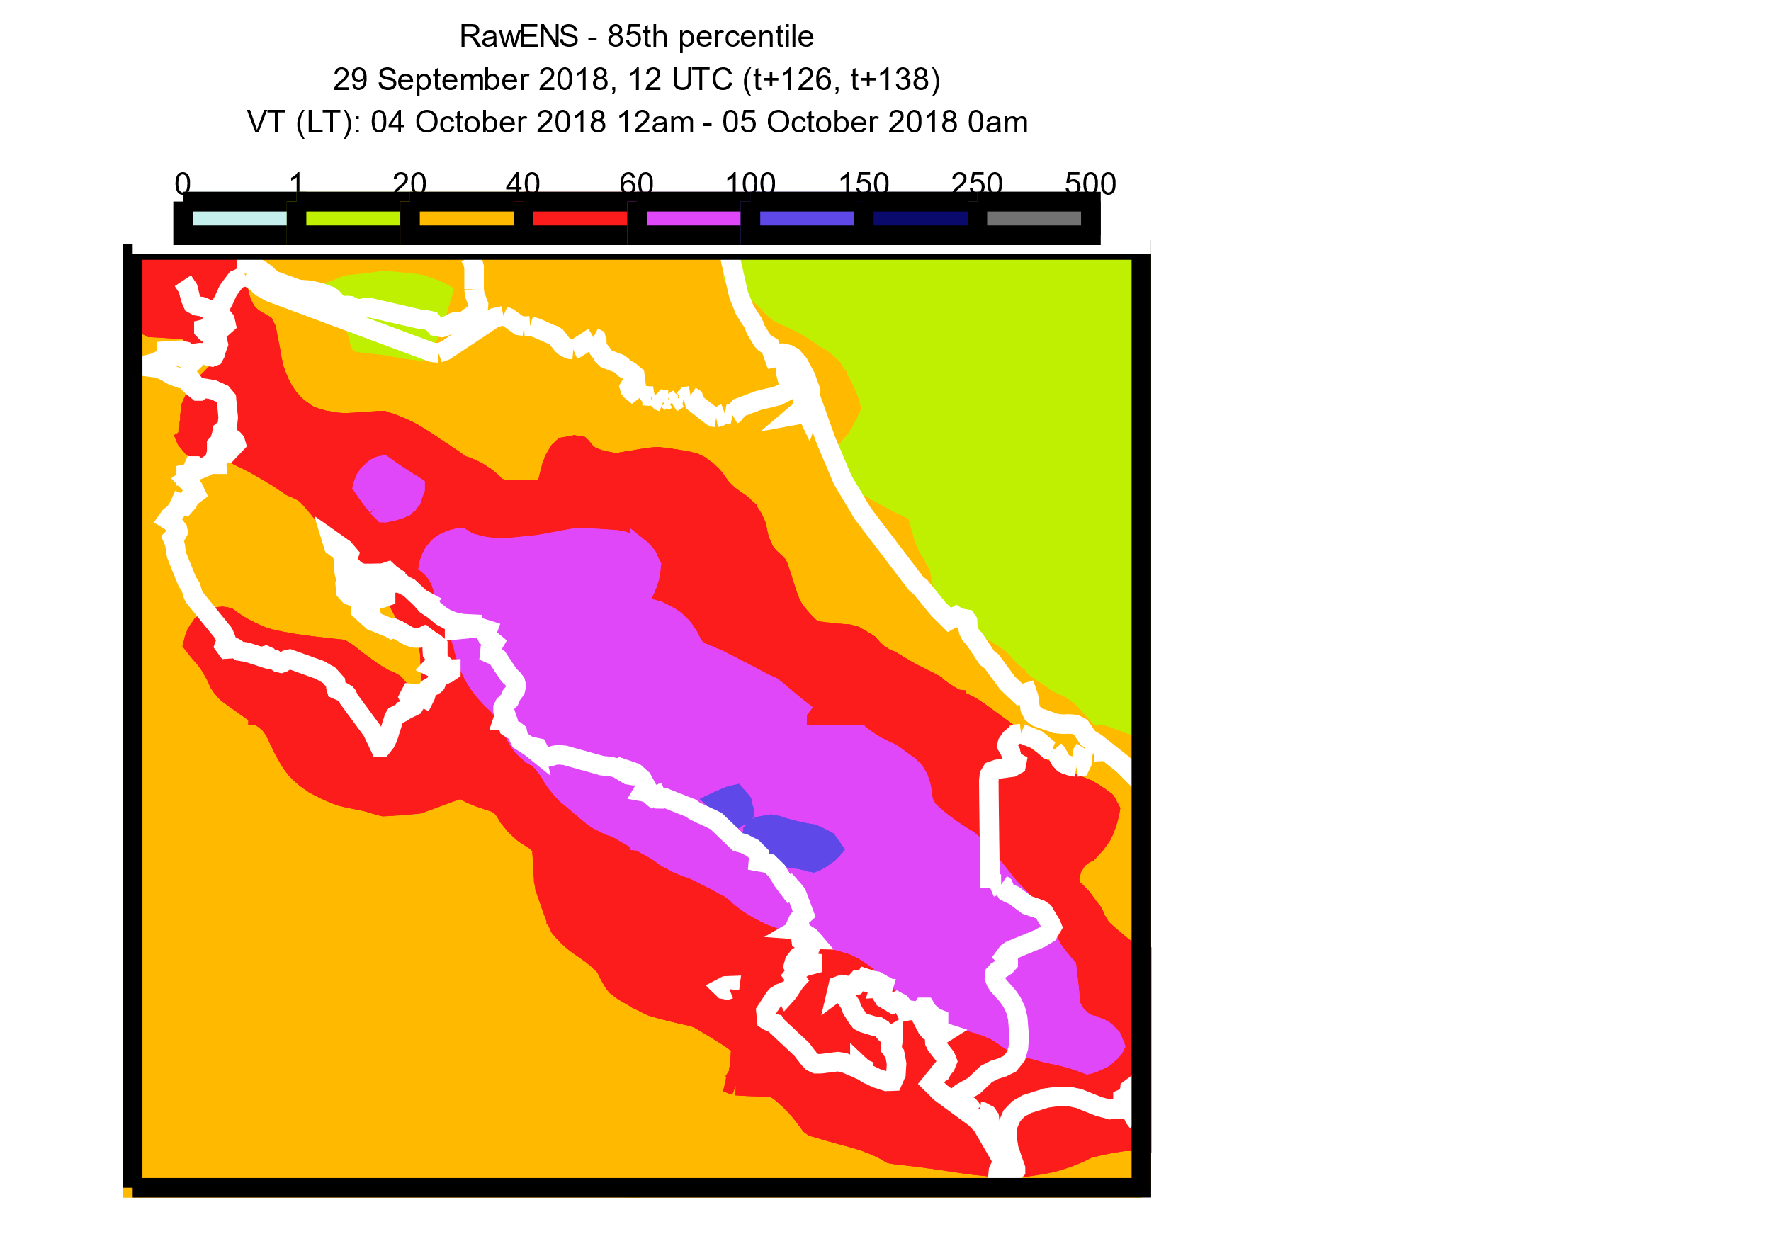
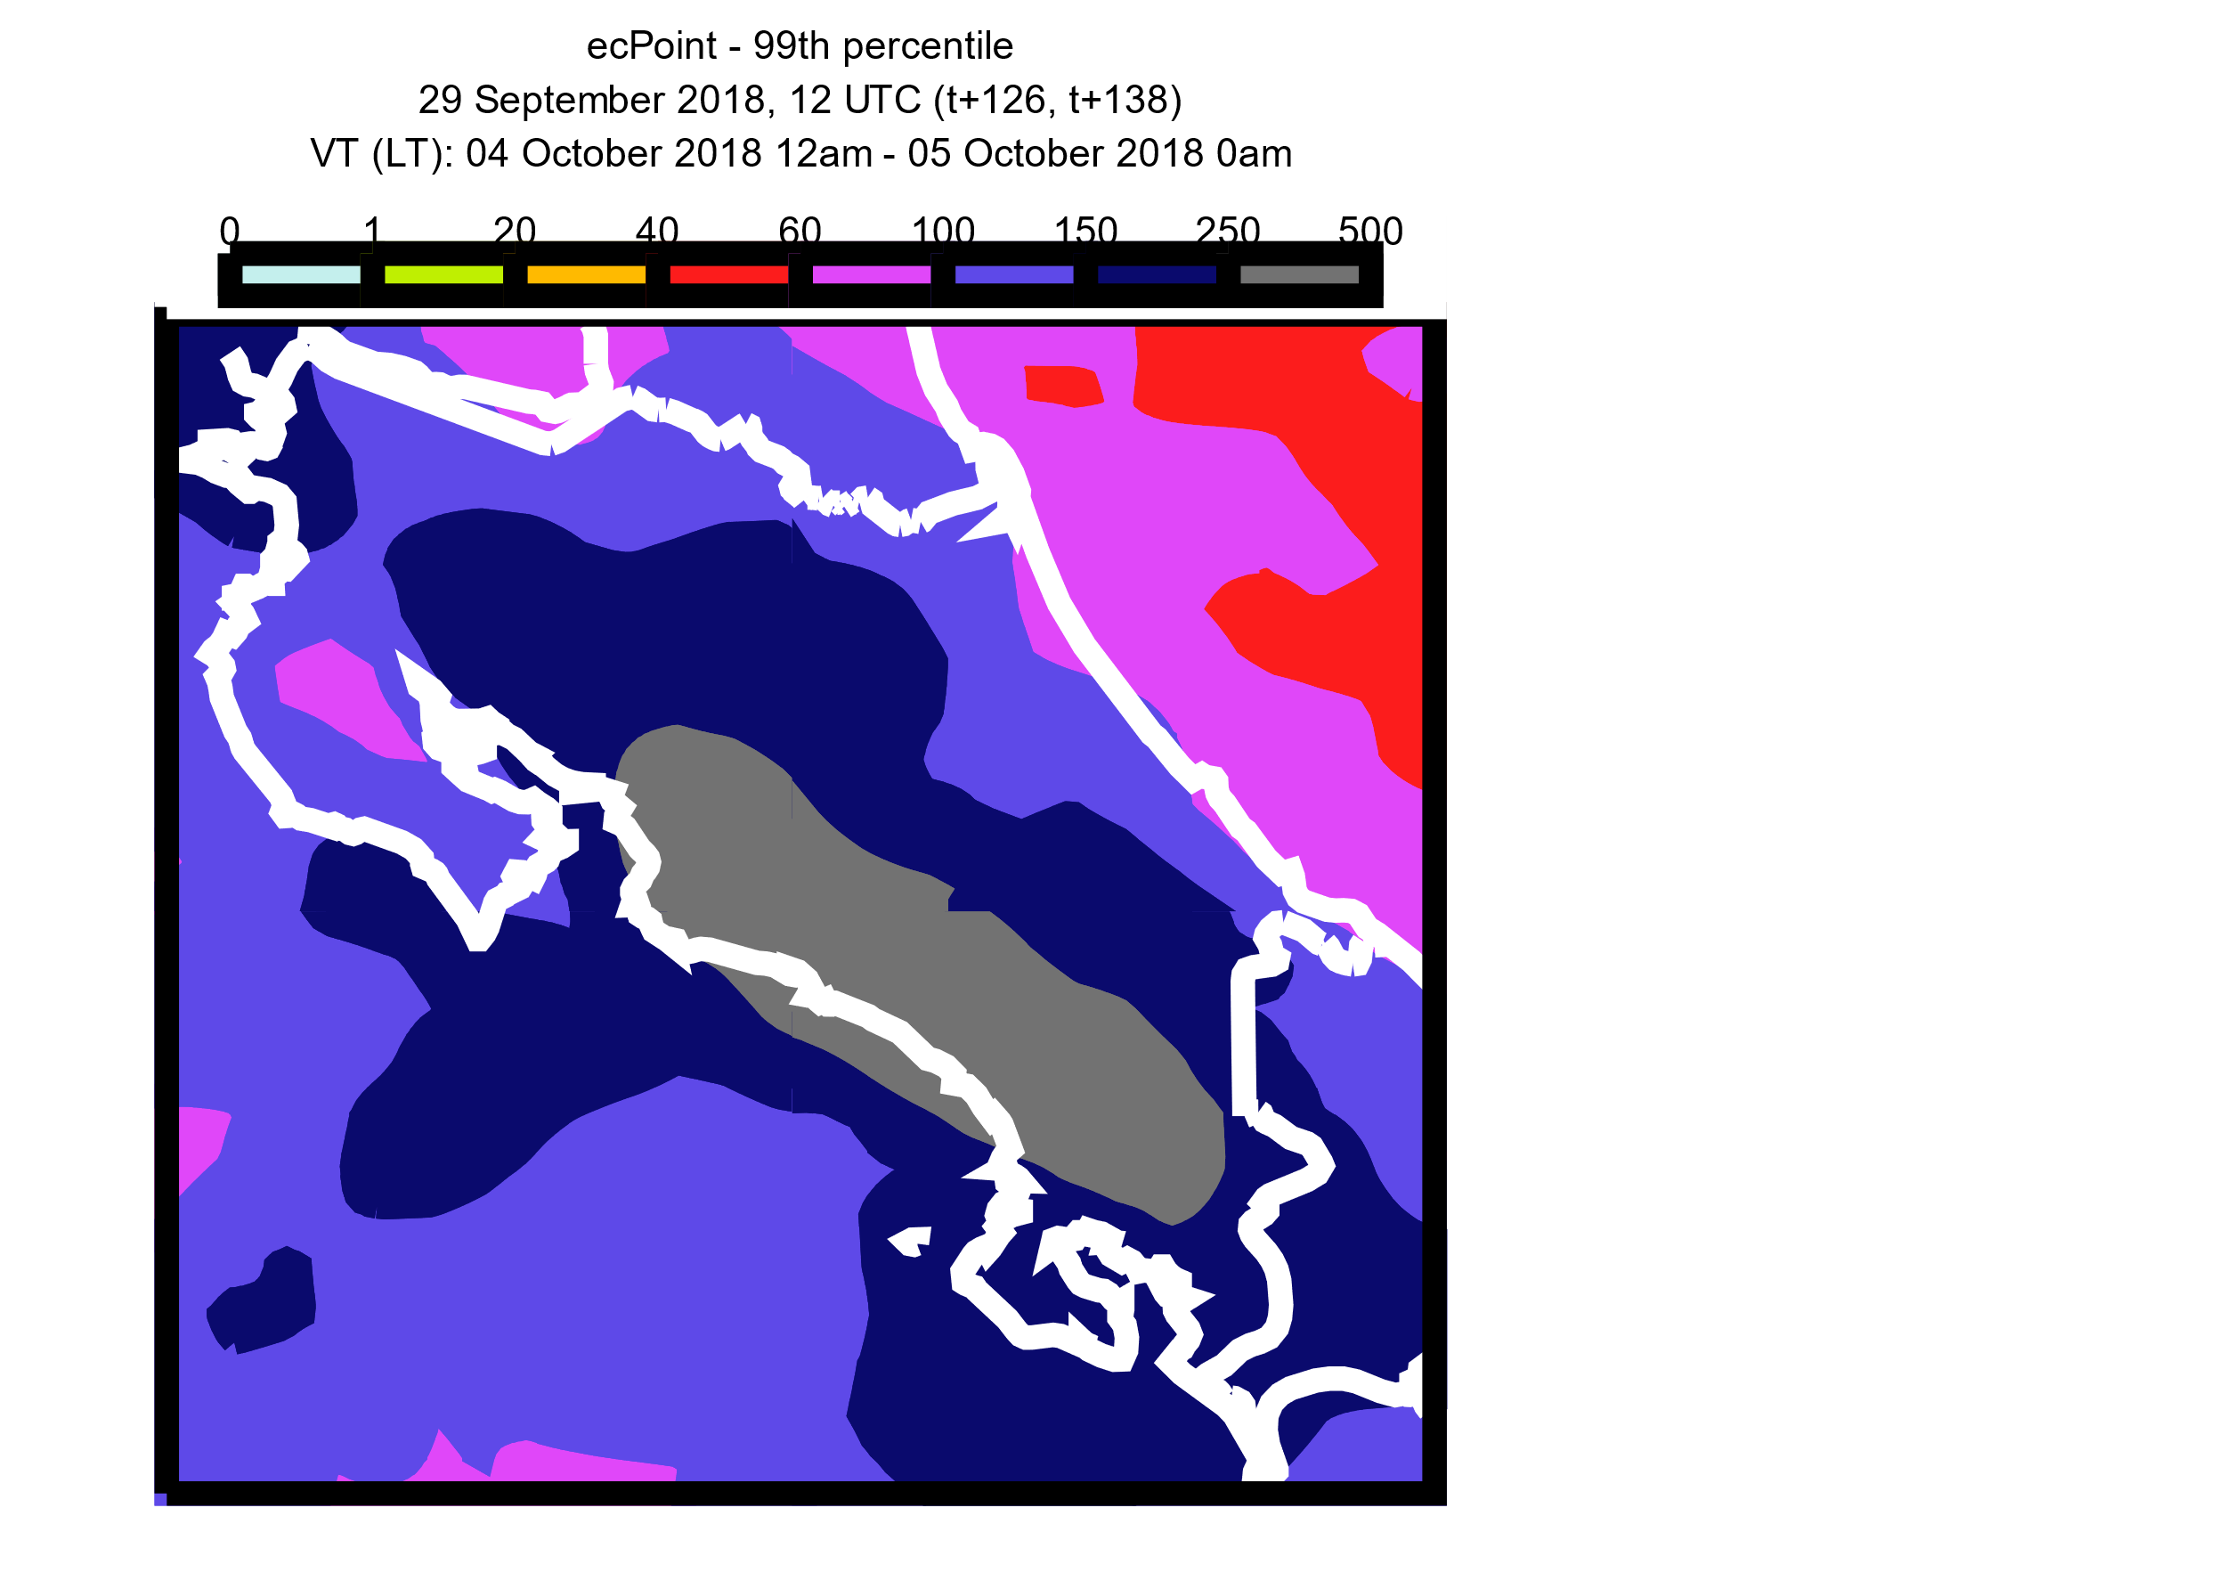
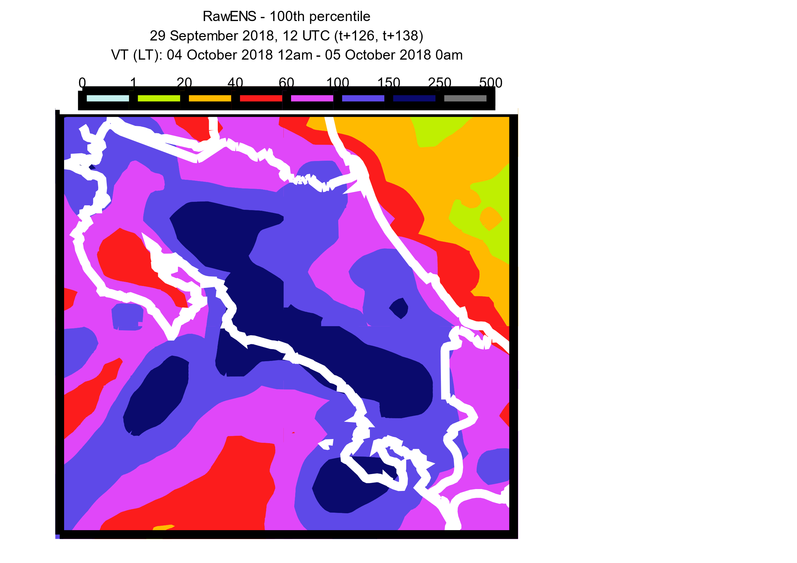
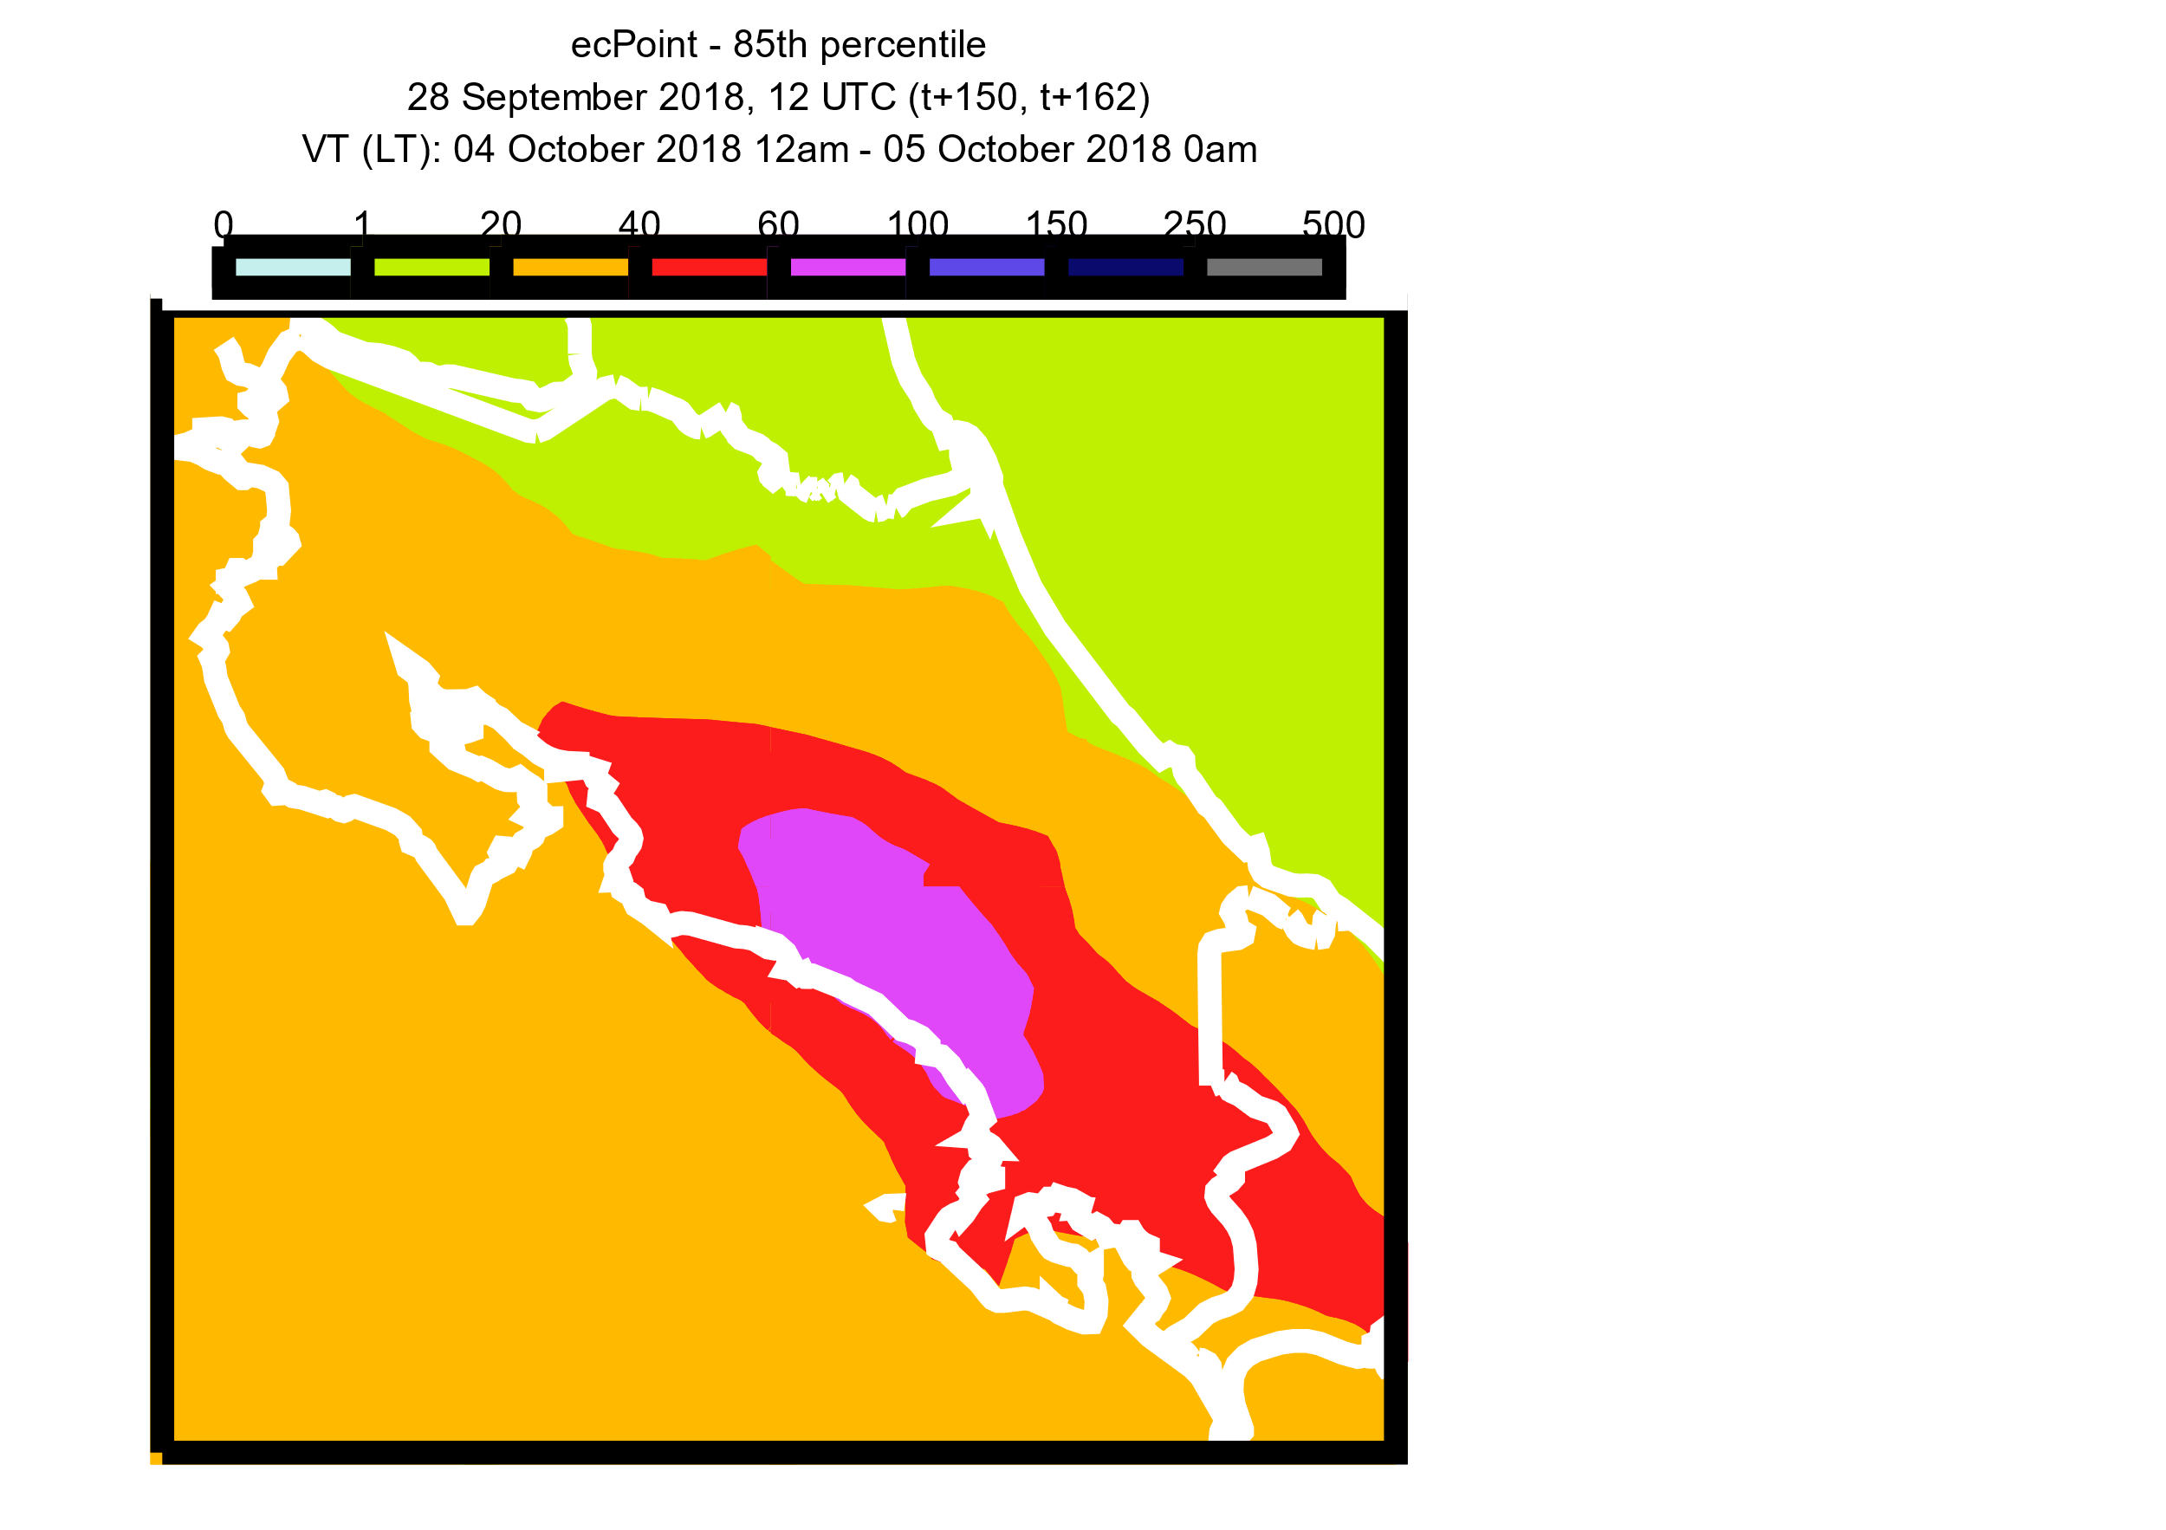
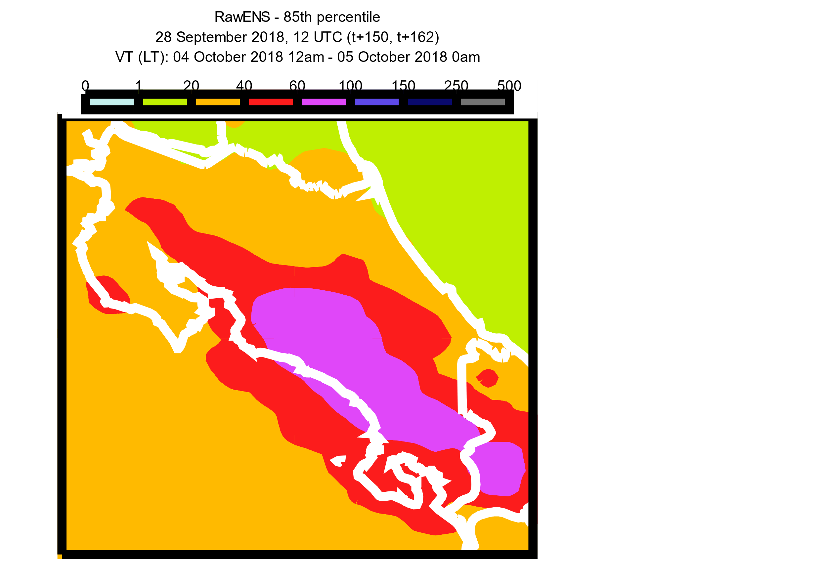
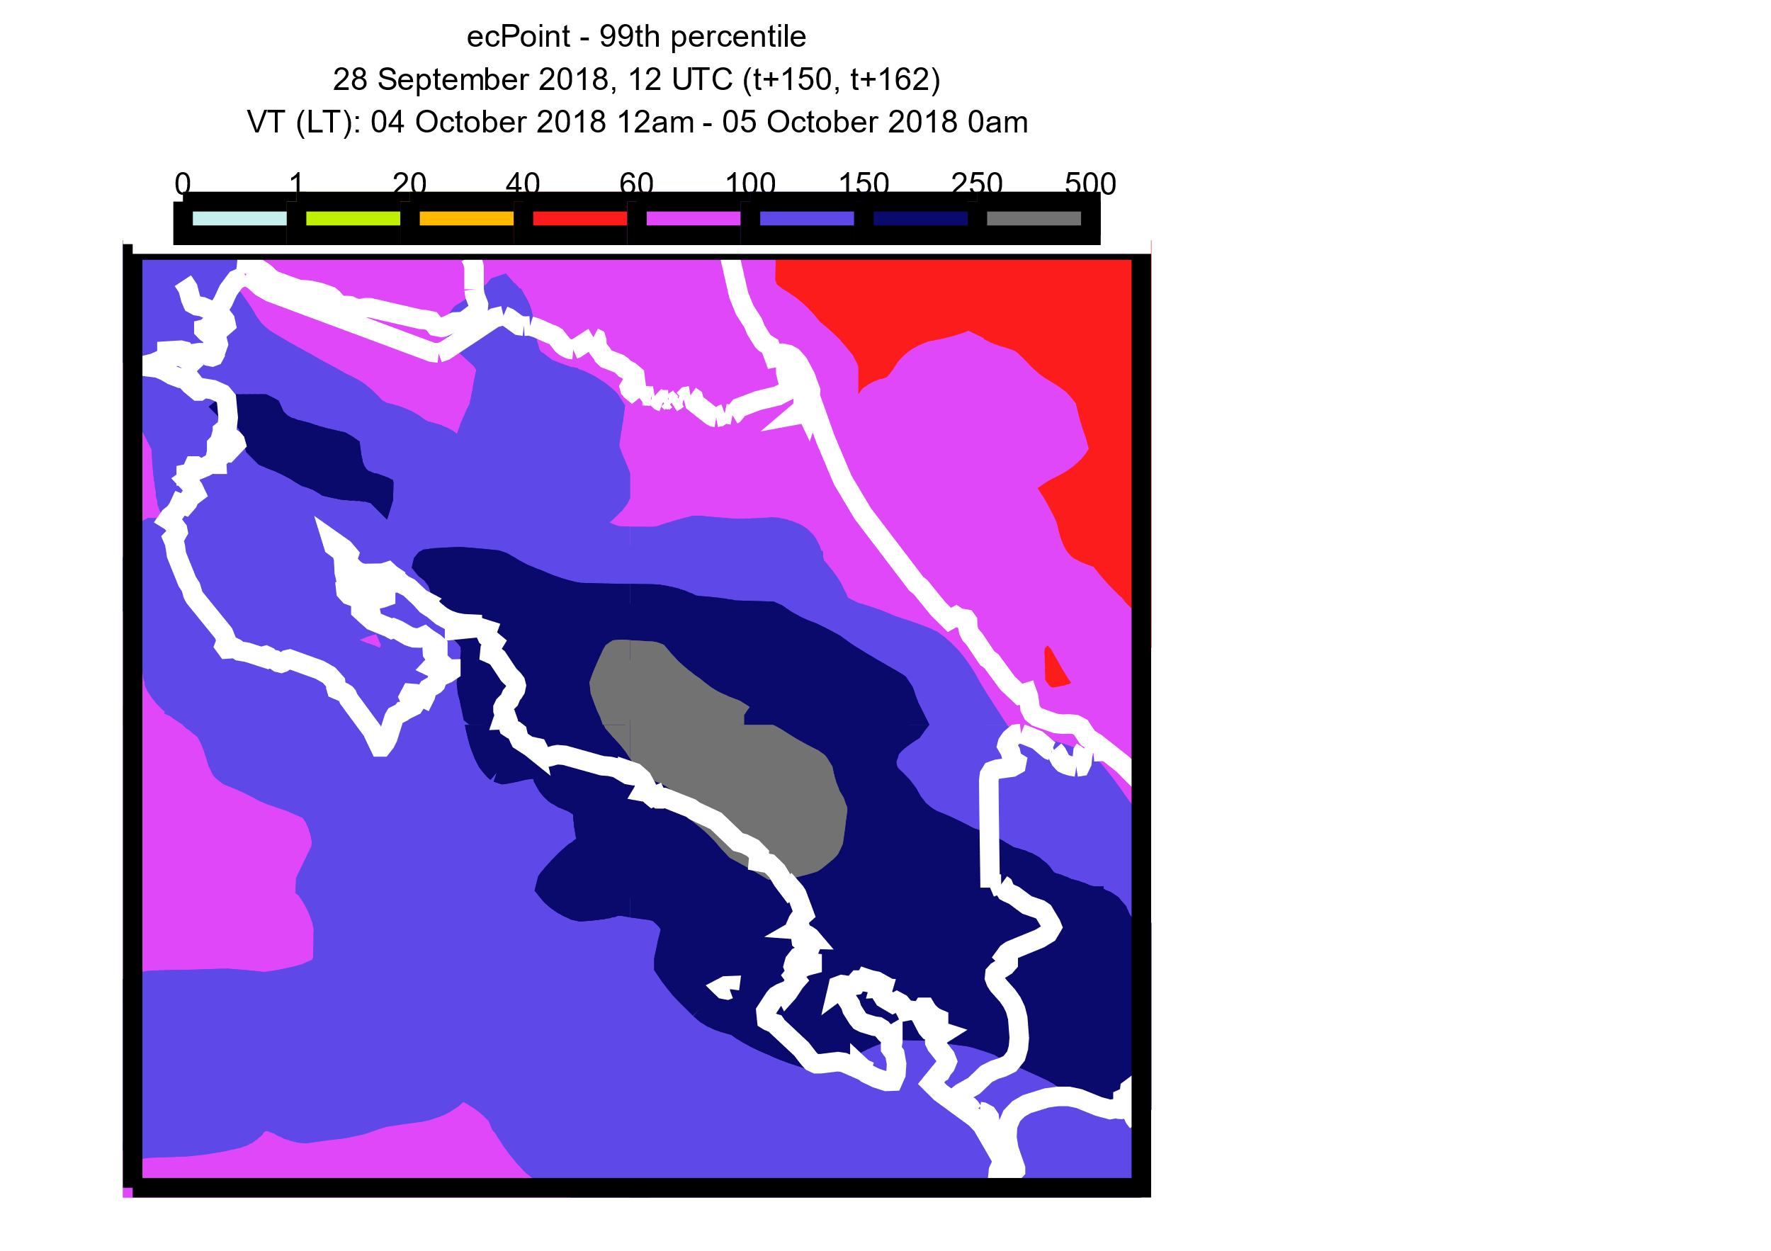
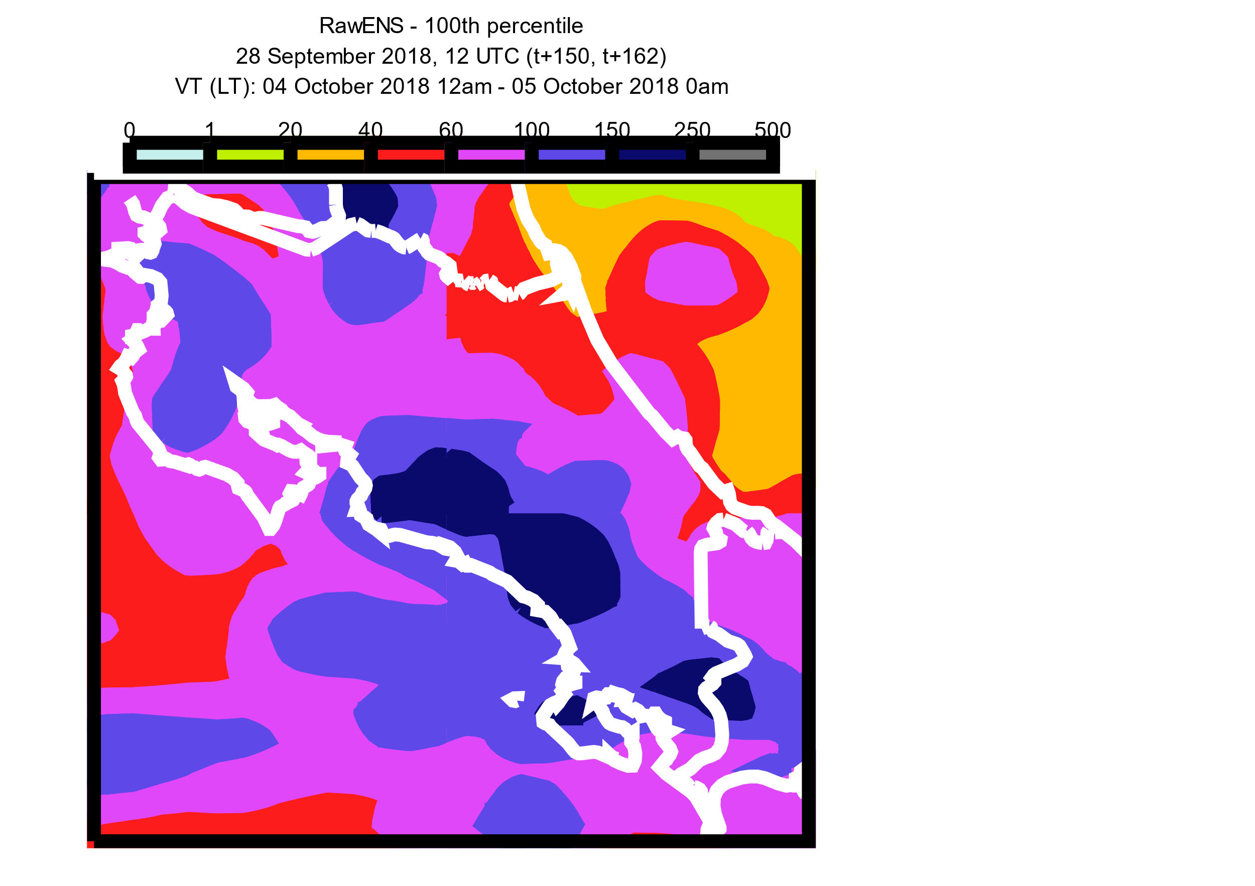
0
1
20
40
mm / 12h
60
100
150
250
500
Rainfall Observations
a
b
c
2018/10/03 06 UTC
to 2018/10/03 18 UTC
(LT: 2018/10/03 0 am
to 2018/10/03 12 am)
2018/10/03 18 UTC
to 2018/10/04 06 UTC
(LT: 2018/10/03 12 am
to 2018/10/04 0 am)
2018/10/04 06 UTC
to 2018/10/04 18 UTC
(LT: 2018/10/04 0 am
to 2018/10/04 12 am)
d
e
f
2018/10/04 18 UTC
to 2018/10/05 06 UTC
(LT: 2018/10/04 12 am
to 2018/10/05 0 am)
2018/10/05 06 UTC
to 2018/10/05 18 UTC
(LT: 2018/10/05 0 am
to 2018/10/05 12 am)
2018/10/05 18 UTC
to 2018/10/06 06 UTC
(LT: 2018/10/05 12 am
to 2018/10/06 0 am)
Forecasts - VT: 2018/10/04 18 UTC to 2018/10/05 06 UTC (LT): 2018/10/04 12 am to 2018/10/05 0 am
ecPoint – Rainfall
85th percentile
Raw ENS
85th percentile
ecPoint – Rainfall
99th percentile
Raw ENS
Wettest Member
Deterministic WRF
(1.5 km, IMN)
2018/10/04 12 UTC
(t+6,t+18), DAY 1
2018/10/04 18 UTC
(t+0,t+12), DAY 1
2018/10/03 12 UTC
(t+30,t+42), DAY 2
2018/10/03 18 UTC
(t+24,t+36), DAY 2
2018/10/02 12 UTC
(t+54,t+66), DAY 3
2018/10/02 18 UTC
(t+48,t+60), DAY 3
2018/10/01 12 UTC
(t+78,t+90), DAY 4
2018/10/01 18 UTC
(t+72,t+84), DAY 4
Lead times not available for WFR
2018/09/30 12 UTC
(t+102,t+114), DAY 5
2018/09/29 12 UTC
(t+126,t+138), DAY 6
2018/09/28 12 UTC
(t+150,t+162), DAY 7

